Slide 1

Public Transport
Spatial Analysis with R
Chia-Jung (Robert) Yeh
葉家榮
2025.10

Slide 2
Data Source
Install Package
install.packages(devtools)
devtools::install_github("ChiaJung-Yeh/TWspdata")
library(TWspdata)
Or Download data via the following link:
https://github.com/ChiaJung-Yeh/Spatial-Analysis/raw/master/data.zip

Slide 3
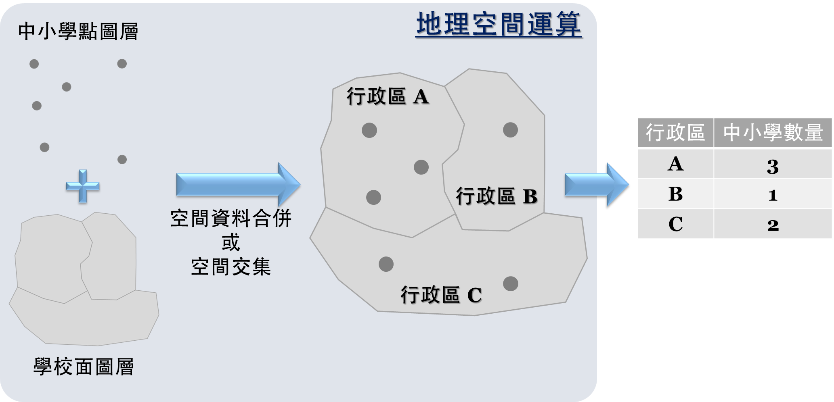
What is Geocomputation?

Slide 4
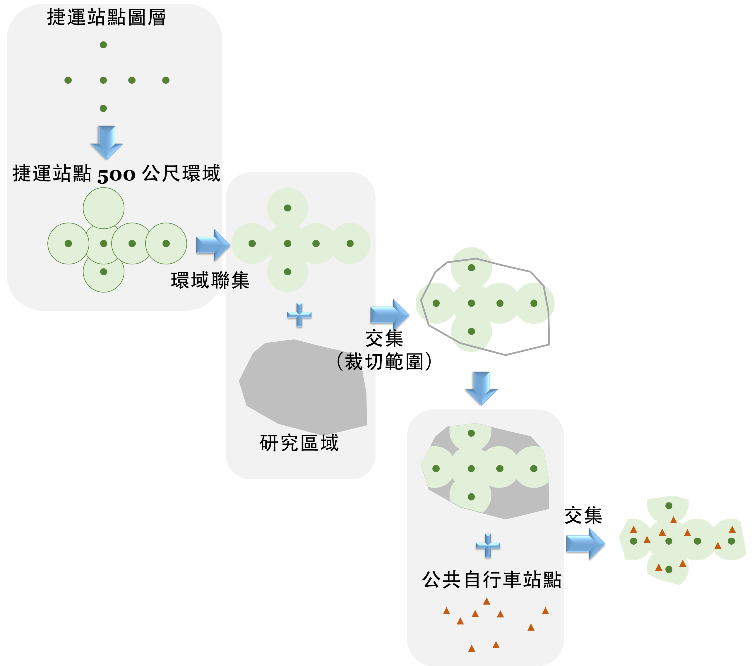
What is Geocomputation?

Slide 5
Merge Spatial Data
left_join()
Join the spatial data and attribute data（Lecture 3）
# use left_join() to merge twp spatial data
left_join(nz, nz_height)
## Error: y should not have class sf; for spatial joins, use st_join
left_join() cannot merge two spatial data!
st_join()
st_join(GEODATA1, GEODATA2, join=, left=)
TRUE（default）
Retain all the spatial data
Only retain the attributes
JOIN method: left join
st_intersects（default）
Use intersect to join data

Slide 6
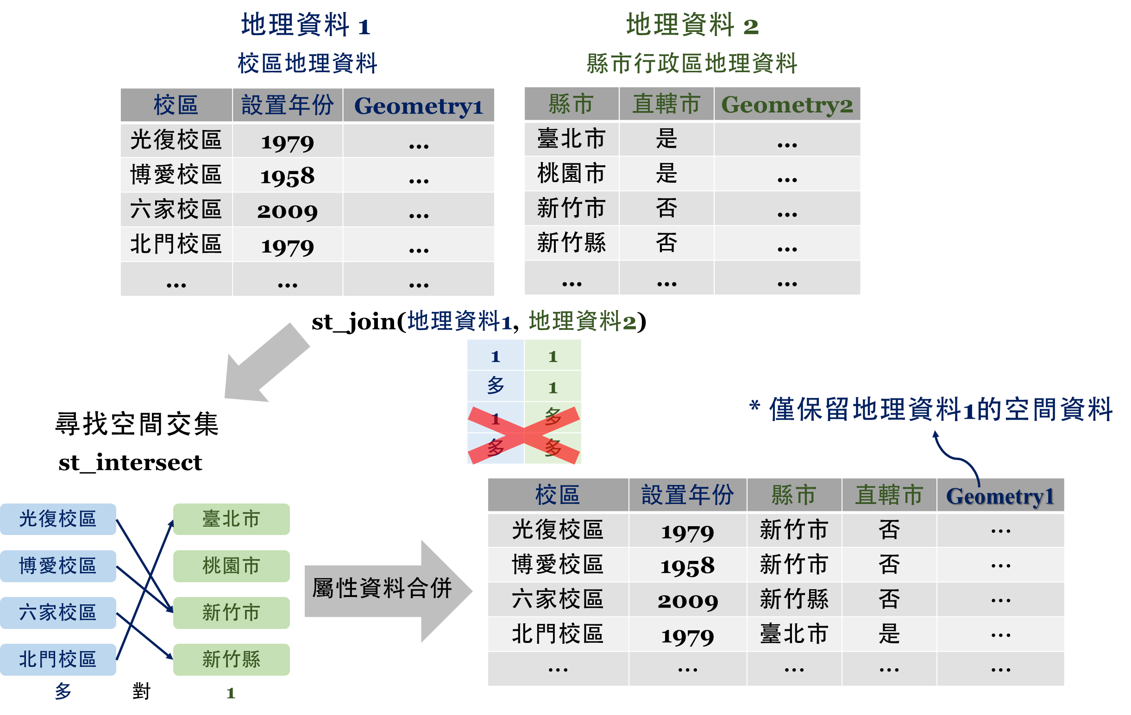
Merge Spatial Data

Slide 7
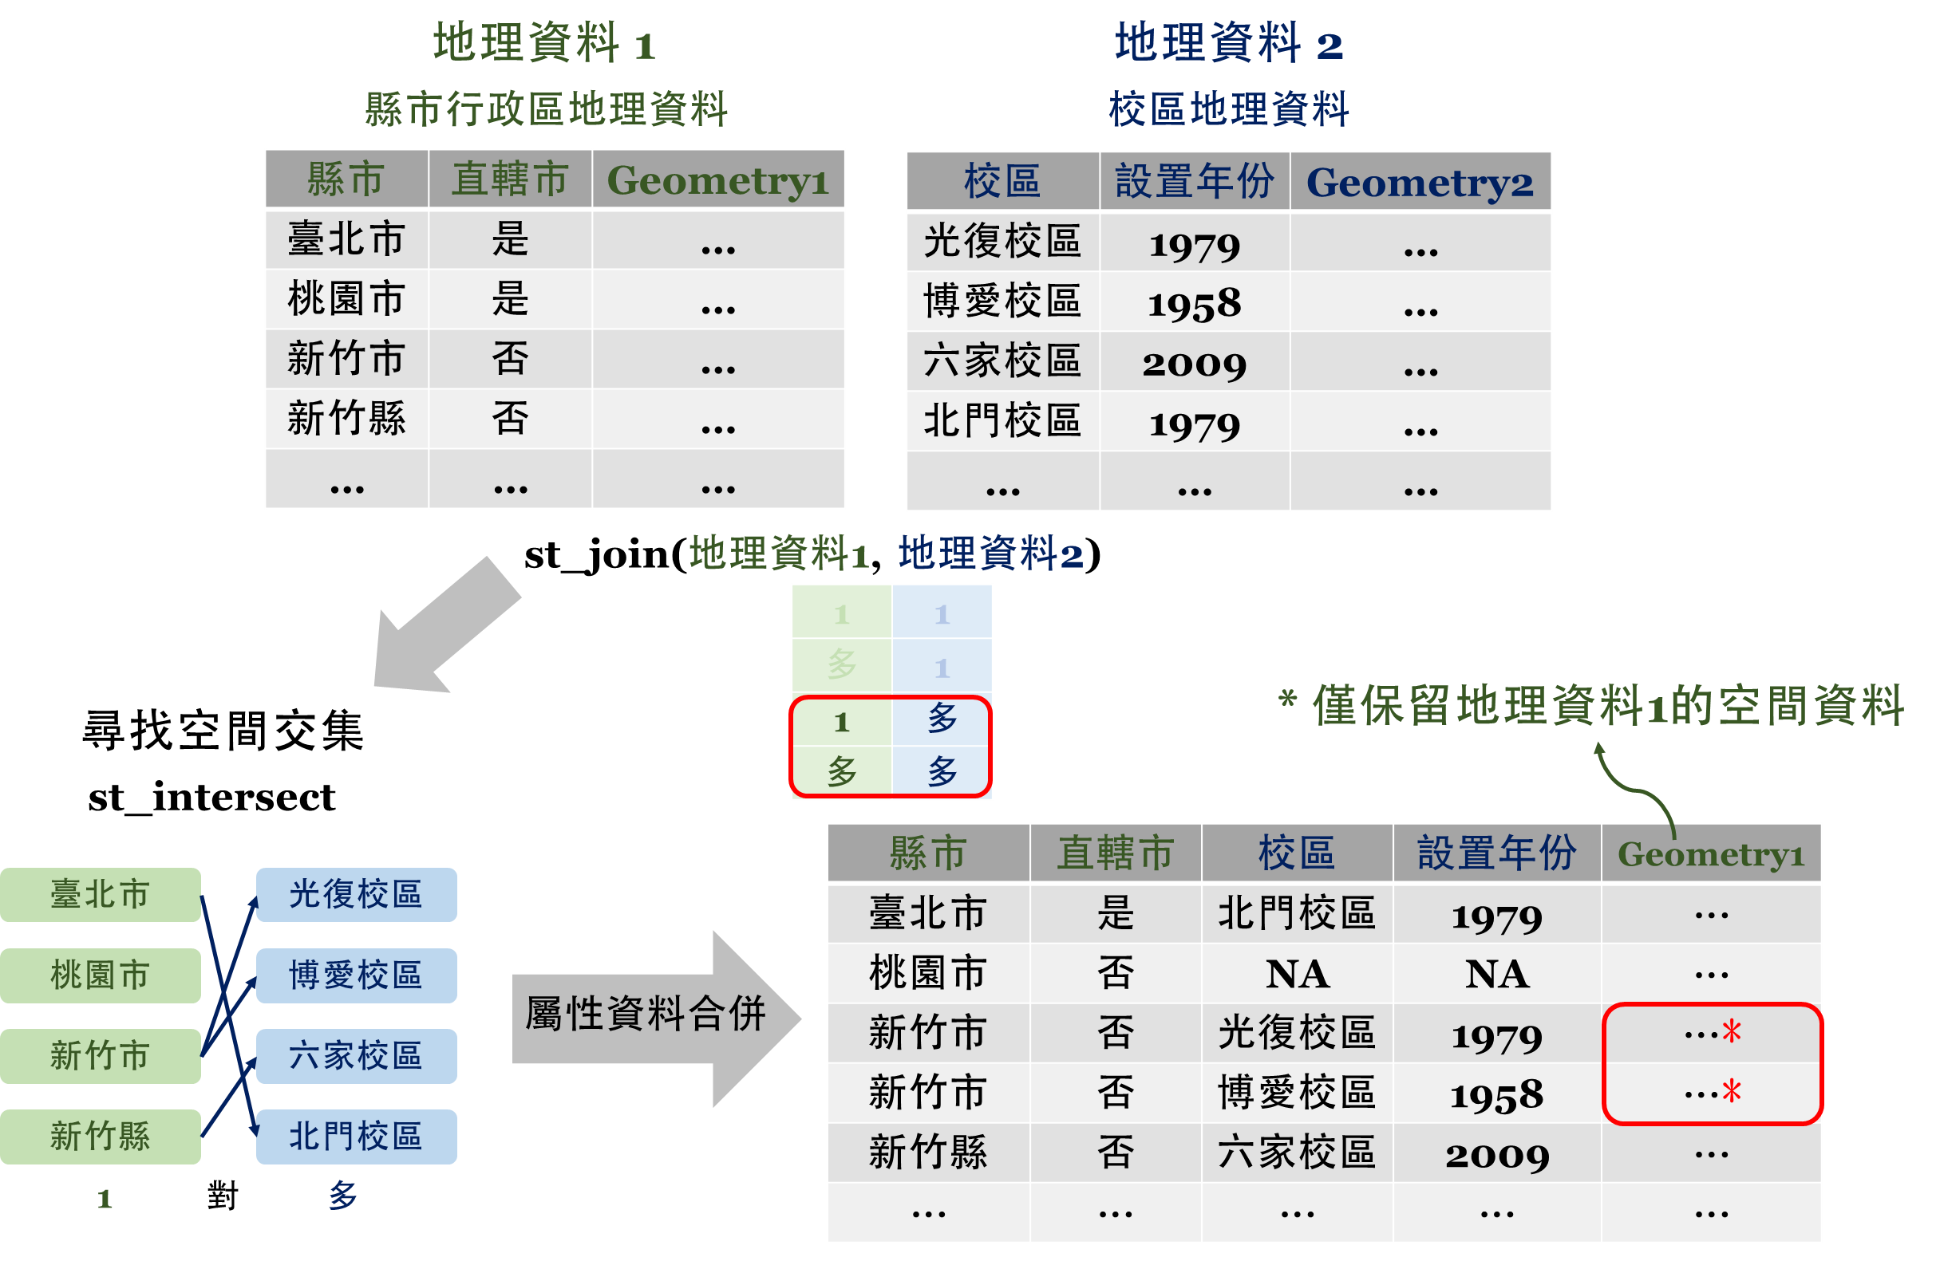
Merge Spatial Data
Reverse the data
Same geometry!!

Slide 8
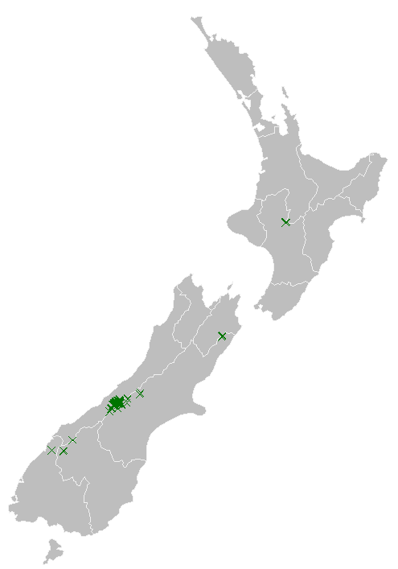
Merge Spatial Data
Data used：
nz_height
nz
# merge spatial data
nz_height_join1=st_join(nz_height, nz)
# view nz_height_join1
head(nz_height_join1)
## Simple feature collection with 6 features and 8 fields
## Geometry type: POINT
## Dimension: XY
## Bounding box: xmin: 1204143 ymin: 5048309 xmax: 1389460 ymax: 5168749
## Projected CRS: NZGD2000 / New Zealand Transverse Mercator 2000
## t50_fid elevation Name Island Land_area Population Median_income Sex_ratio geometry
## 1 2353944 2723 Southland South 31196.06 98300 29500 0.9785069 POINT (1204143 5049971)
## 2 2354404 2820 Otago South 31186.31 224200 26300 0.9511694 POINT (1234725 5048309)
## 3 2354405 2830 Otago South 31186.31 224200 26300 0.9511694 POINT (1235915 5048745)
## 4 2369113 3033 West Coast South 23245.46 32400 26900 1.0139072 POINT (1259702 5076570)
## 5 2362630 2749 Canterbury South 44504.50 612000 30100 0.9753265 POINT (1378170 5158491)
## 6 2362814 2822 Canterbury South 44504.50 612000 30100 0.9753265 POINT (1389460 5168749)
Point data

Slide 9
Merge Spatial Data
Reverse the input data
Data used：
nz_height
nz
# merge spatial data
nz_height_join2=st_join(nz, nz_height)
# view nz_height_join2
head(nz_height_join2)
## Simple feature collection with 6 features and 8 fields
## Geometry type: MULTIPOLYGON
## Dimension: XY
## Bounding box: xmin: 1568217 ymin: 5646123 xmax: 2051016 ymax: 6191874
## Projected CRS: NZGD2000 / New Zealand Transverse Mercator 2000
## Name Island Land_area Population Median_income Sex_ratio t50_fid elevation geom
## 1 Northland North 12500.561 175500 23400 0.9424532 NA NA MULTIPOLYGON (((1745493 600...
## 2 Auckland North 4941.573 1657200 29600 0.9442858 NA NA MULTIPOLYGON (((1803822 590...
## 3 Waikato North 23900.036 460100 27900 0.9520500 2408397 2751 MULTIPOLYGON (((1860345 585...
## 3.1 Waikato North 23900.036 460100 27900 0.952050 2408406 2720 MULTIPOLYGON (((1860345 585...
## 3.2 Waikato North 23900.036 460100 27900 0.952050 2408411 2732 MULTIPOLYGON (((1860345 585...
## 4 Bay of… North 12071.145 29990 26200 0.928039 NA NA MULTIPOLYGON (((2049387 583...
Same geometry!!
Polygon

Slide 10
Summarise Spatial Data
# Sum
group_by(GEODATA, X)%>%
summarise(sum(Y))
# Average
group_by(GEODATA, X)%>%
summarise(mean(Y))
# Counts
group_by(GEODATA, X)%>%
summarise(n())

Slide 11
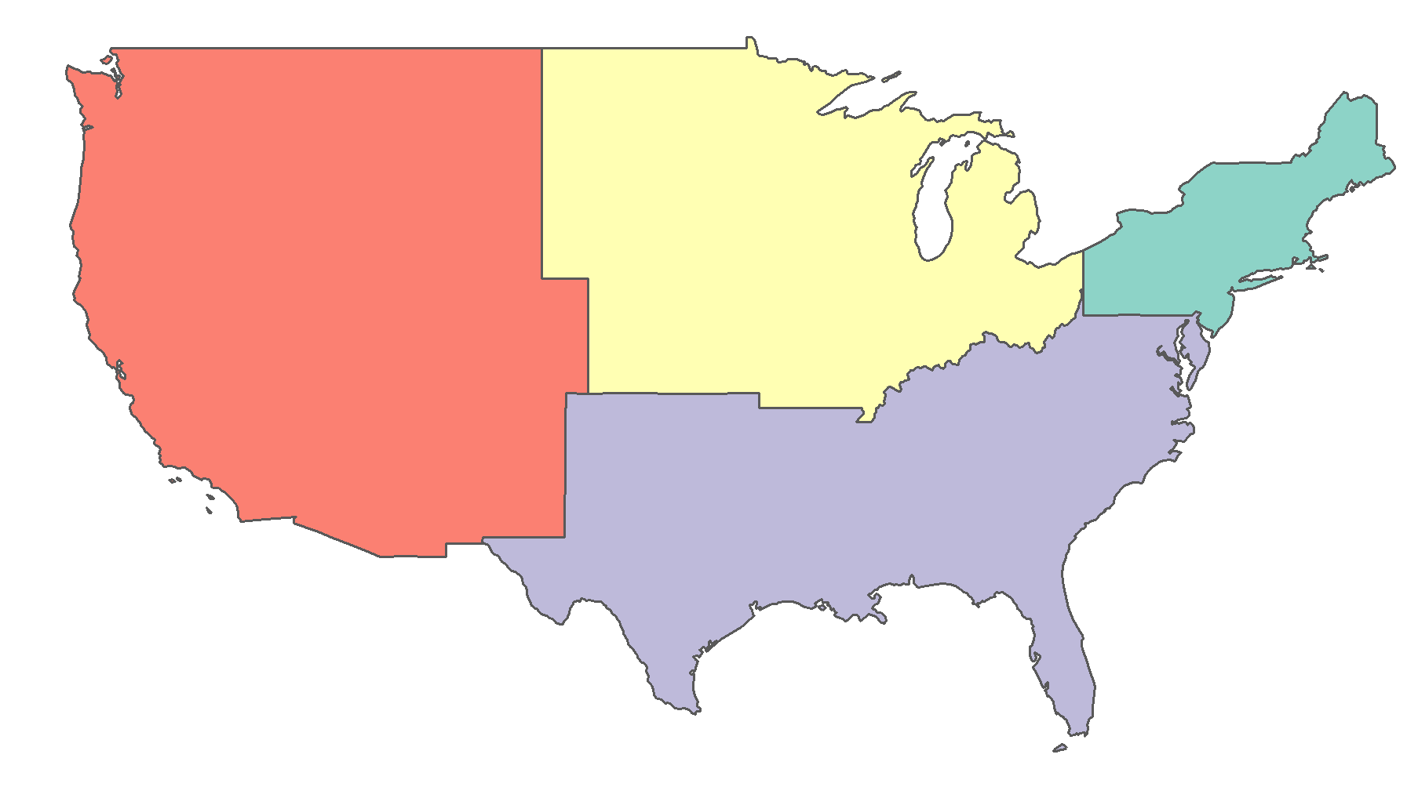
Summarise Spatial Data
# Summarise spatial and attribute
us_states_sf2=group_by(us_states, REGION)%>%
summarise(total_pop_15=sum(total_pop_15))
# view us_states_sf2
head(us_states_sf2)
## Simple feature collection with 4 features and 2 fields
## Geometry type: MULTIPOLYGON
## Dimension: XY
## Bounding box: xmin: -124.704 ymin: 24.559 xmax: -66.982 ymax: 49.384
## Geodetic CRS: NAD83
## # A tibble: 4 x 3
## REGION total_pop_15 geometry
## <fct> <dbl> <MULTIPOLYGON [arc_degree]>
## 1 Norteast 55989520 (((-76.99106 39.72006, -77.53488 39.720~
## 2 Midwest 67546398 (((-104.0555 43.85348, -104.0577 44.997~
## 3 South 118575377 (((-94.59485 29.4679, -94.54639 29.572~
## 4 West 72264052 (((-124.411 42.25055, -124.4351 42.440~
Merge Spatial Data：
Remove the border of states
Merge Attributes：
Sum of population

Slide 12
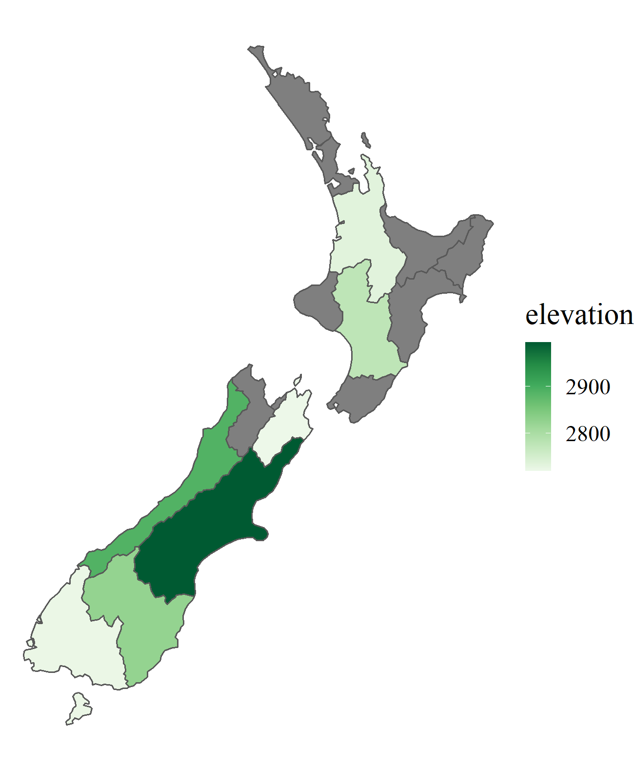
aggregate(x=GEODATA1["Y"], by=GEODATA2, FUN=METHOD)
Summarise Spatial Data
# Summarise spatial and attribute
nz_ave_ele=aggregate(x=nz_height["elevation"], by=nz, FUN=mean)
# view nz_ave_ele
head(nz_ave_ele)
## Simple feature collection with 6 features and 1 field
## Geometry type: MULTIPOLYGON
## Dimension: XY
## Bounding box: xmin: 1568217 ymin: 5518431 xmax: 2089533 ymax: 6191874
## Projected CRS: NZGD2000 / New Zealand Transverse Mercator 2000
## elevation geometry
## 1 NA MULTIPOLYGON (((1745493 600...
## 2 NA MULTIPOLYGON (((1803822 590...
## 3 2734.333 MULTIPOLYGON (((1860345 585...
## 4 NA MULTIPOLYGON (((2049387 583...
## 5 NA MULTIPOLYGON (((2024489 567...
## 6 NA MULTIPOLYGON (((2024489 567...
Summarise based on two spatial data

Slide 13
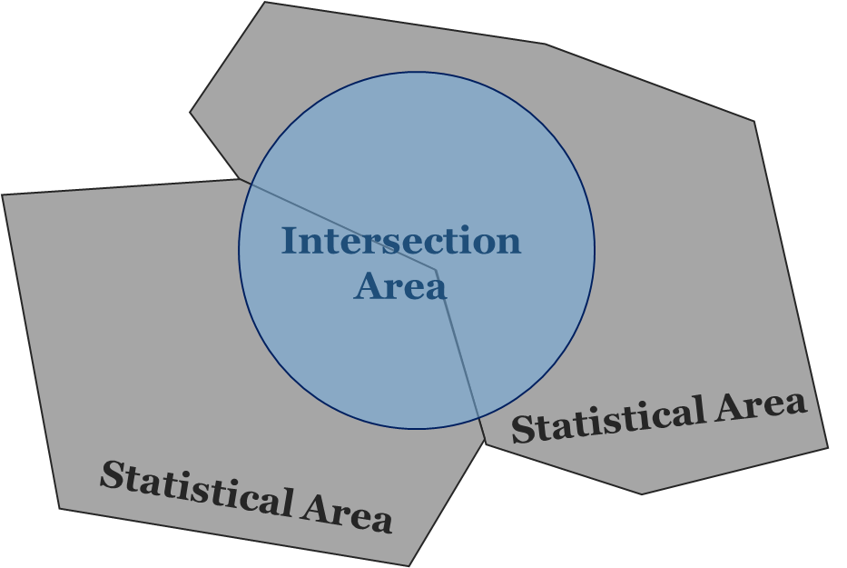
Spatial Interpolation
Estimate the sum or average based on overlapping but incongruent spatial data.
Assumption:
The attribute is evenly distributed

Slide 14
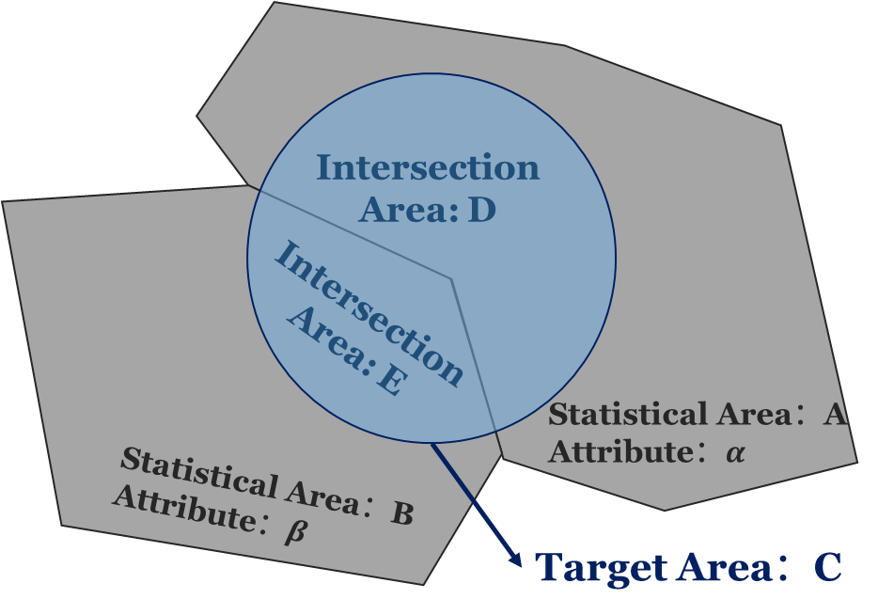
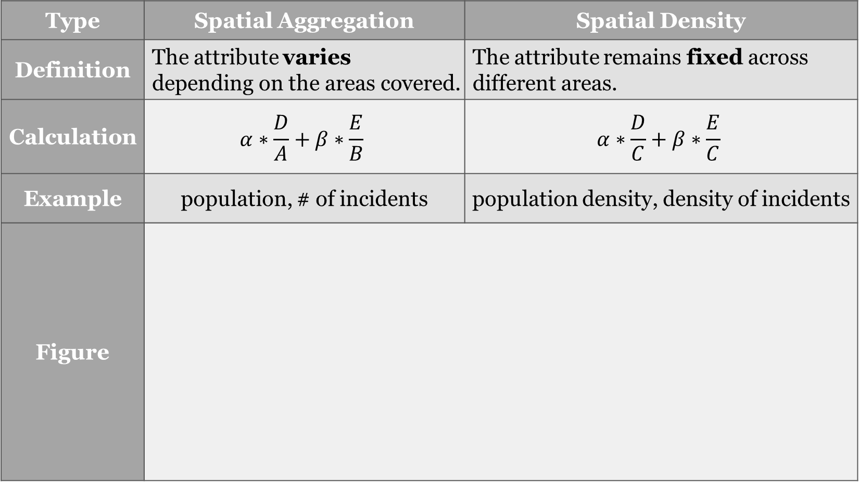
Spatial Interpolation
Type | Spatial Aggregation | Spatial Density
Definition | The attribute varies depending on the areas covered. | The attribute remains fixed across different areas.
Calculation | $$α∗\frac{D}{A}+β∗\frac{E}{B}$$ | $$α∗\frac{D}{C}+β∗\frac{E}{C}$$
Example | population, # of incidents | population density, density of incidents
Figure

Slide 15
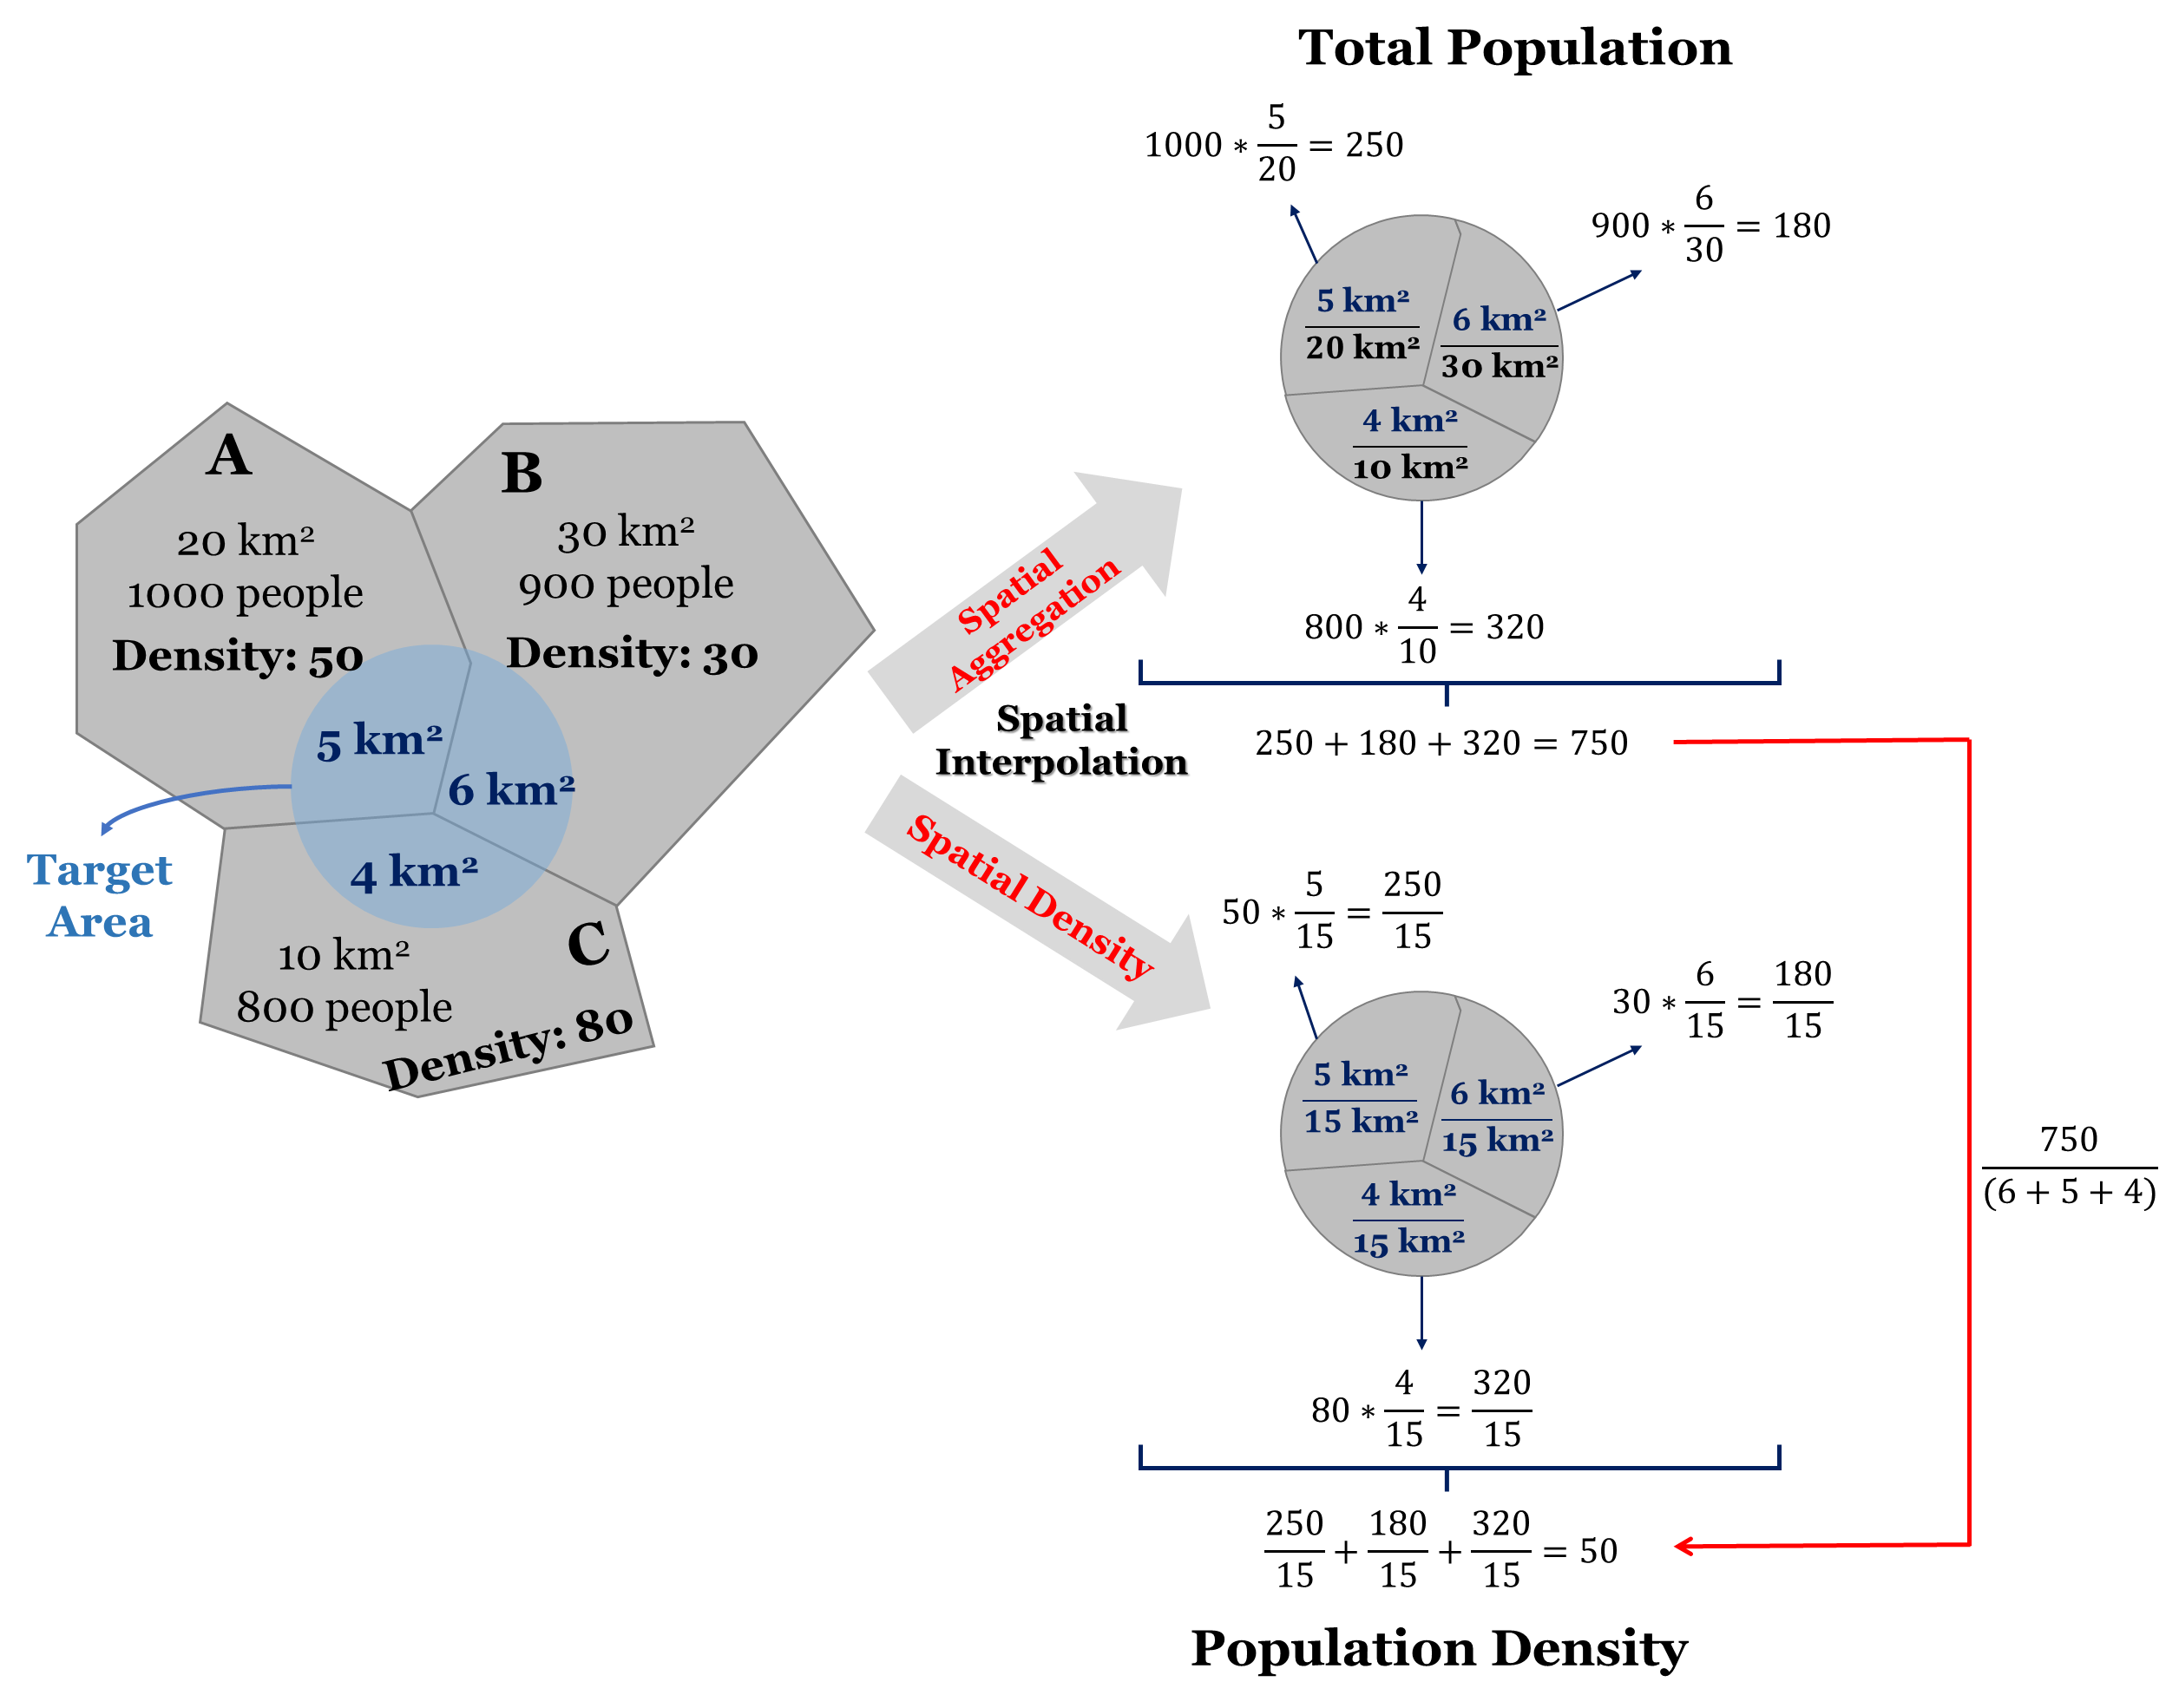
Spatial Interpolation

Slide 16
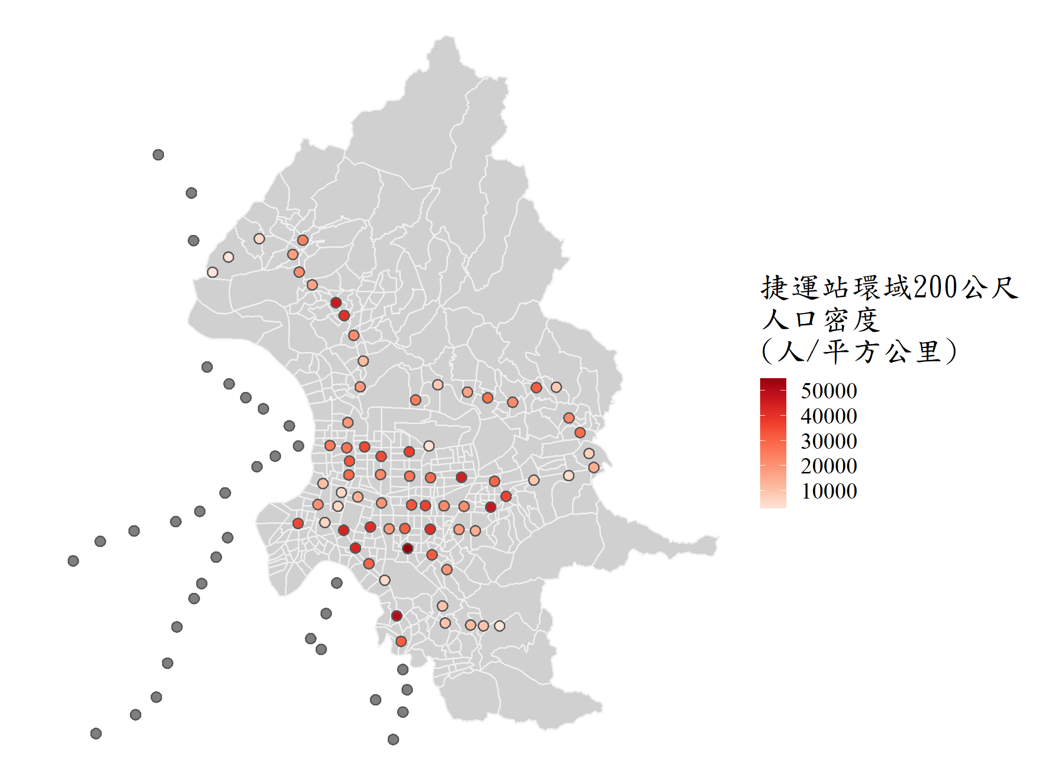
# calculate the total population within 200 buffer of MRT station
PP_interpo=st_interpolate_aw(taipei_village_map["PP"],
taipei_mrt_station_buf, extensive=T)
# 查看PP_interpo前六筆資料
head(PP_interpo)
## Simple feature collection with 86 features and 1 field
## Attribute-geometry relationship: 0 constant, 1 aggregate, 0 identity
## Geometry type: POLYGON
## Dimension: XY
## Bounding box: xmin: 296891.3 ymin: 2764892 xmax: 312439 ymax: 2781295
## Projected CRS: TWD97 / TM2 zone 121
## First 10 features:
## PP geometry
## 1 374.4286 POLYGON ((308696.3 2765704,...
## 2 1217.1181 POLYGON ((308052.9 2765705,...
## 3 1482.4531 POLYGON ((307544.1 2765739,...
## 4 1232.8199 POLYGON ((306534.7 2765818,...
## 5 1265.7893 POLYGON ((306426.3 2766497,...
## 6 2442.4100 POLYGON ((306600.8 2767942,...
Spatial Interpolation
計算臺北各捷運站 方圓200公尺內的人口總數

Slide 17
Union
# union of all villages
vil_uni=st_union(taipei_village_map)
# view vil_uni
vil_uni
========================================================================
## Simple feature collection with 6 features and 2 fields
## Geometry type: GEOMETRYCOLLECTION
## Dimension: XY
## Bounding box: xmin: 305841 ymin: 2763273 xmax: 308496.3 ymax: 2767942
## Projected CRS: TWD97 / TM2 zon
## POLYGON ((298768 2776910, 298761.1 2776913, 298...
# check data type of vil_uni
class(vil_uni)
========================================================================
## [1] "sfc_POLYGON" "sfc"
Taipei Village

Slide 18
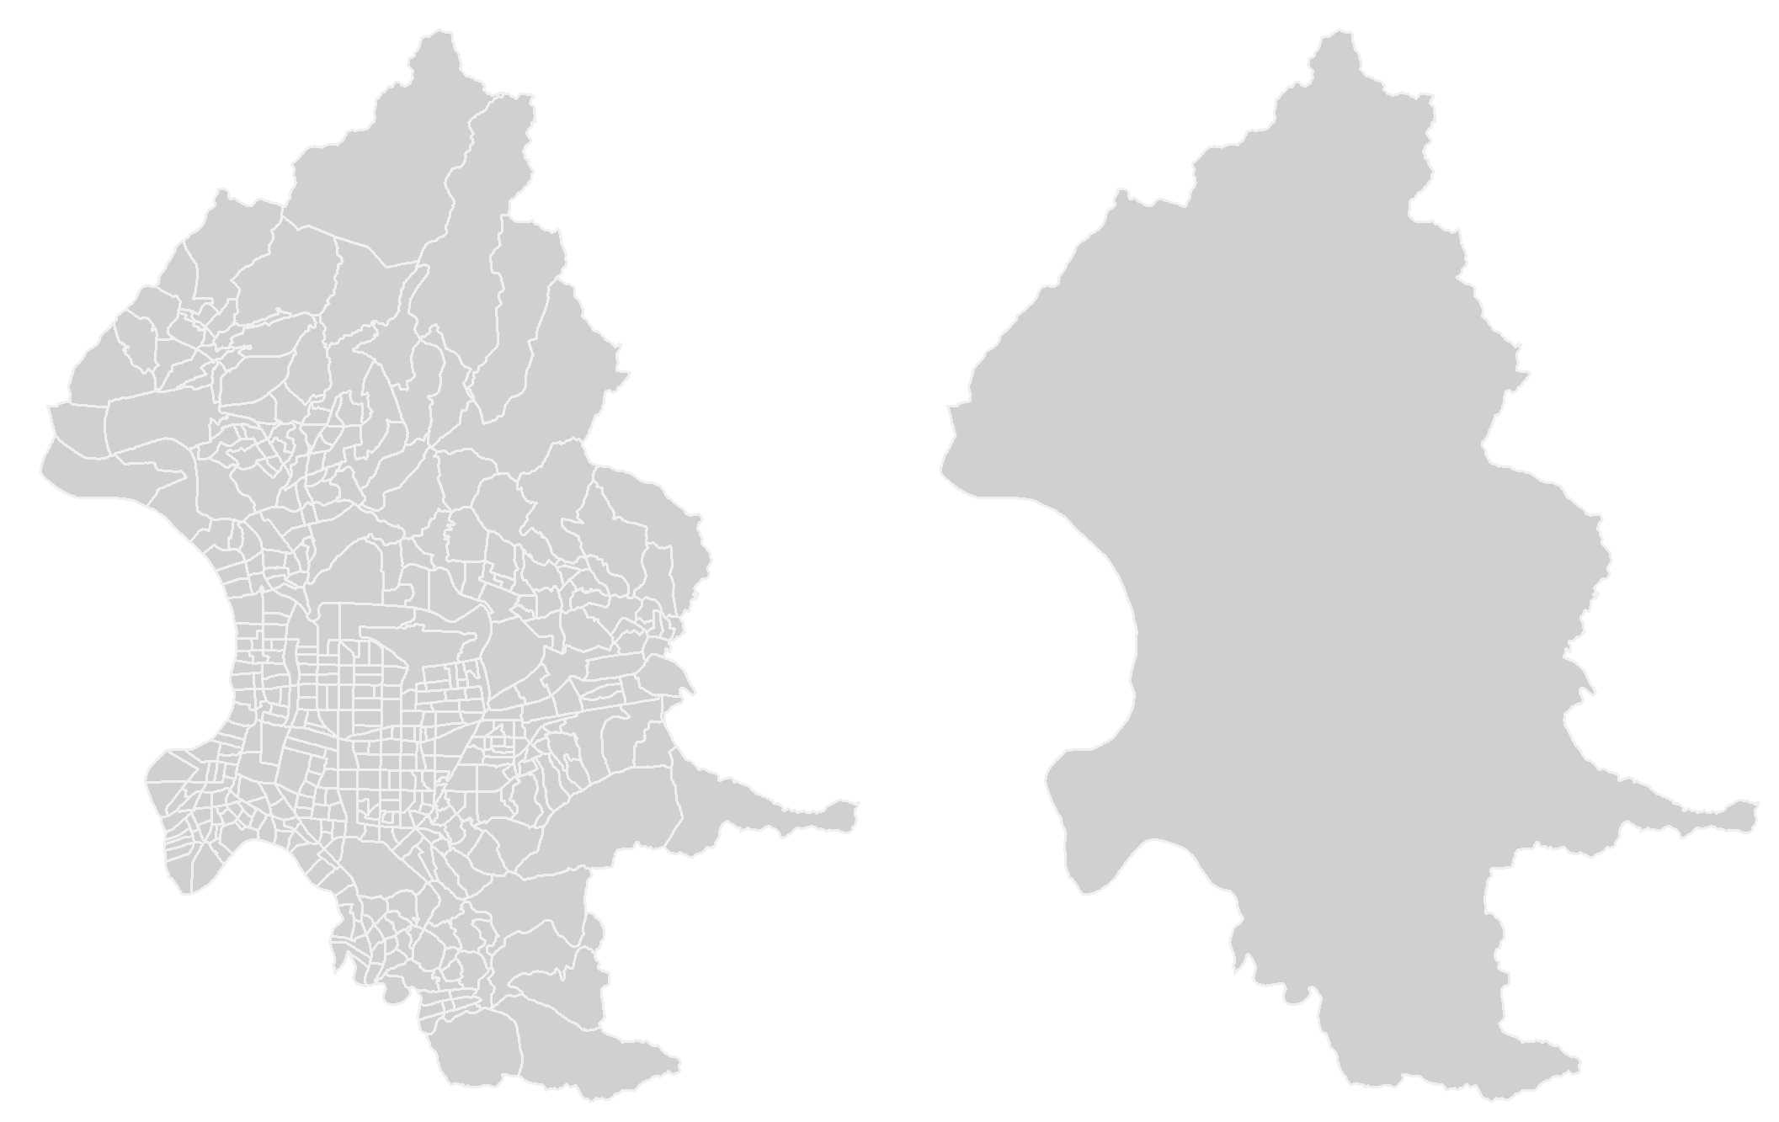
Union
Taipei Village
Taipei City
Taipei Village
Union

Slide 19
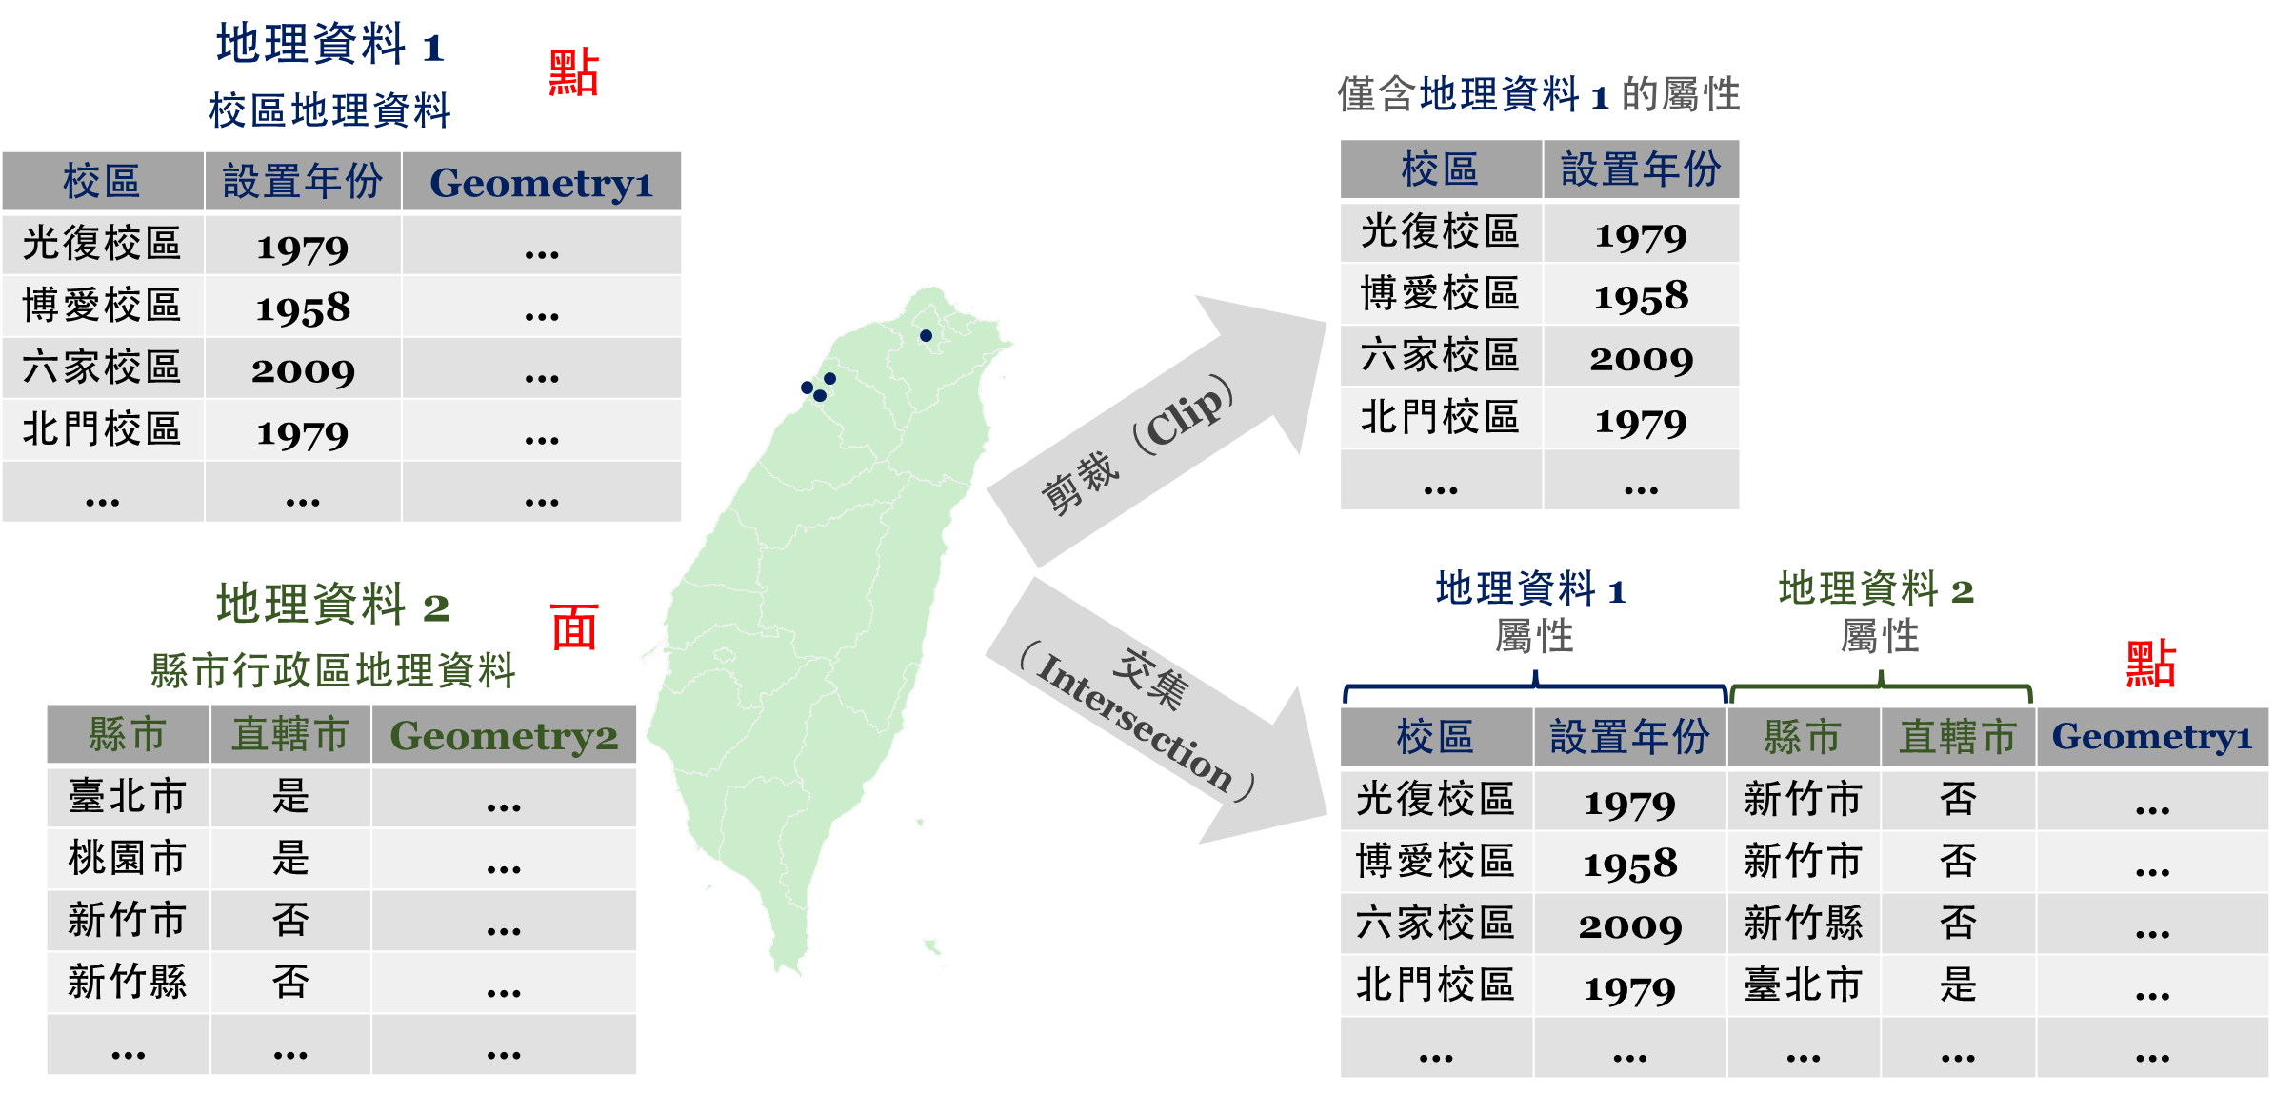
Intersect
Clip & Intersection

Slide 20
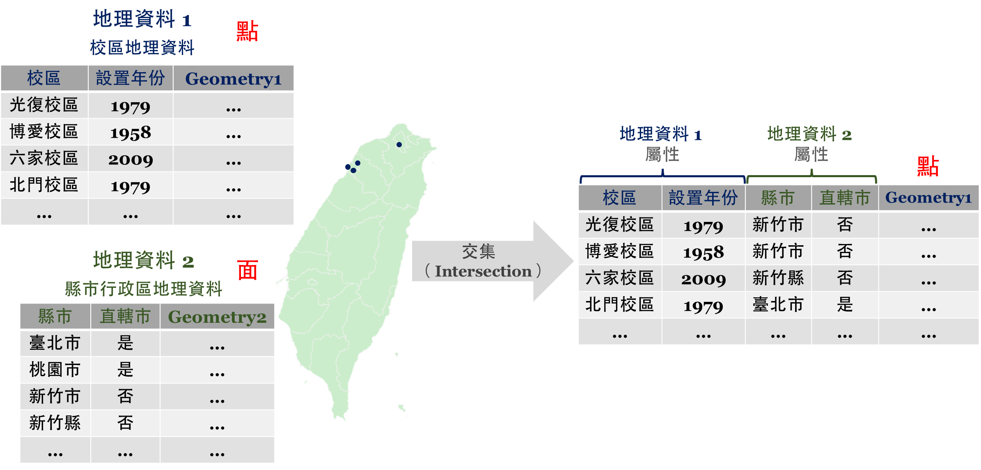
Intersect
st_intersection(GEODATA1, GEODATA2)
Retain the lowest hierarchy of geometry
（Point < Line < Polygon）

Slide 21
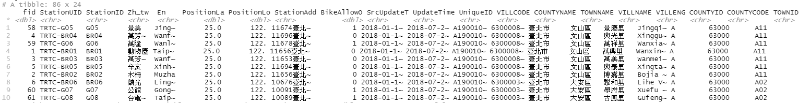
Intersect
st_intersection(GEODATA1, GEODATA2)
# intersection of MRT station and village
mrt_stop_inter=st_intersection(taipei_mrt_station, taipei_village_map)
Simple feature collection with 86 features and 23 fields
Geometry type: POINT
Dimension: XY
Bounding box: xmin: 297091.3 ymin: 2765092 xmax: 312239 ymax: 2781095
Projected CRS: TWD97 / TM2 zone 121
# A tibble: 86 x 24
Point
Polygon
Retain the point data
Retrieve all the villages of MRT stations

Slide 22
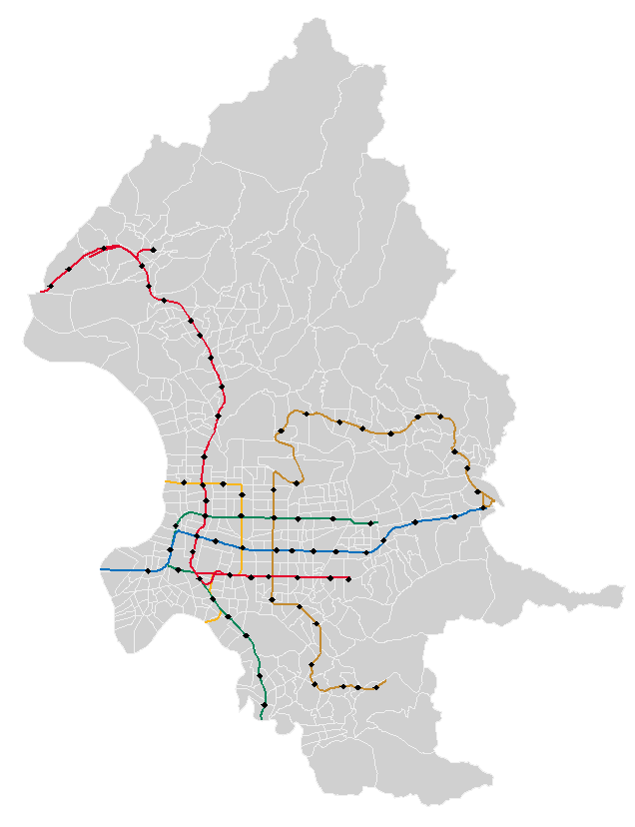
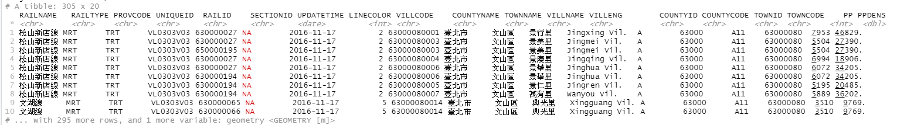
Intersect
st_intersection(GEODATA1, GEODATA2)
# intersection of MRT line and village
mrt_route_inter=st_intersection(taipei_mrt_route, taipei_village_map)
Simple feature collection with 305 features and 19 fields
Geometry type: GEOMETRY
Dimension: XY
Bounding box: xmin: 296716.6 ymin: 2764528 xmax: 312638.1 ymax: 2781162
Projected CRS: TWD97 / TM2 zone 121
# A tibble: 305 x 20
Line
Polygon
Retain the line data
Retrieve all the villages of MRT lines

Slide 23
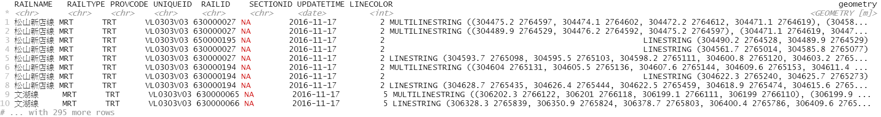
Intersect
[ Clip ]
st_intersection(GEODATA1, GEODATA2$geometry)
# intersection of MRT line and village
mrt_route_inter=st_intersection(taipei_mrt_route, taipei_village_map$geometry)
Simple feature collection with 305 features and 8 fields
Geometry type: GEOMETRY
Dimension: XY
Bounding box: xmin: 296716.6 ymin: 2764528 xmax: 312638.1 ymax: 2781162
Projected CRS: TWD97 / TM2 zone 121
# A tibble: 305 x 9
Line
Polygon (only geometry)
Retain the line data
Retain attributes of GEODATA1
Clip the data by GEODATA2

Slide 24
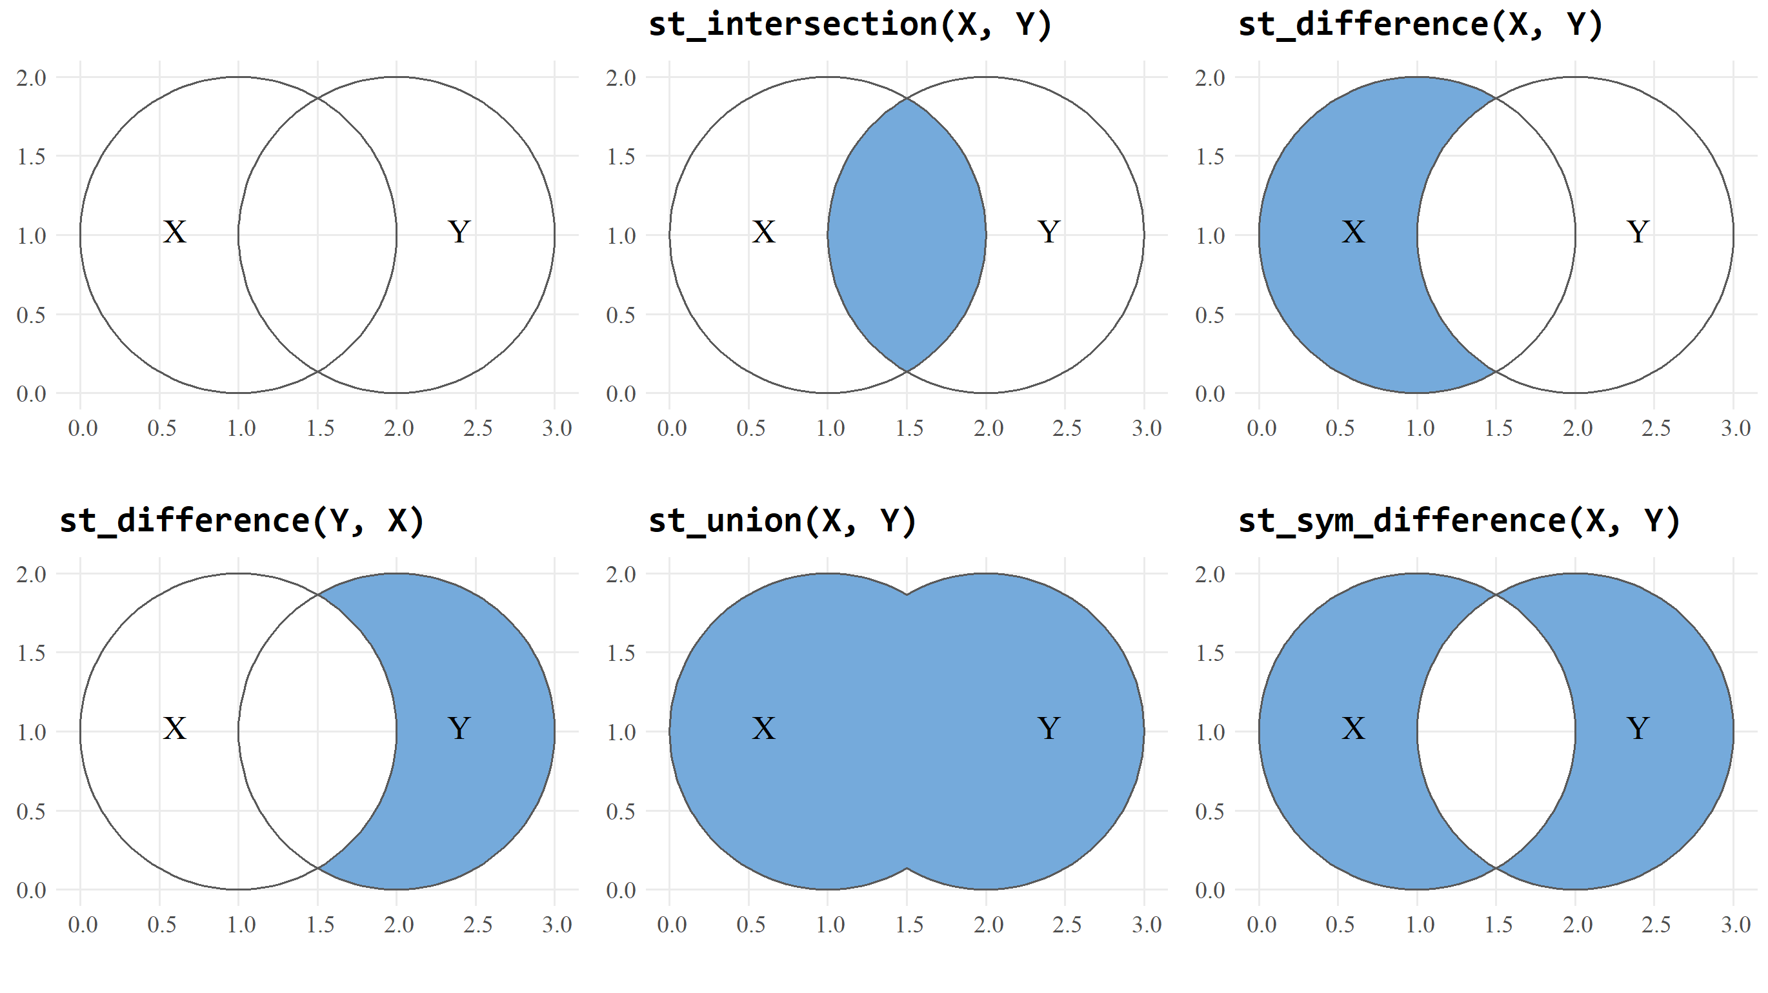
Intersect
Other Spatial Operations

Slide 25
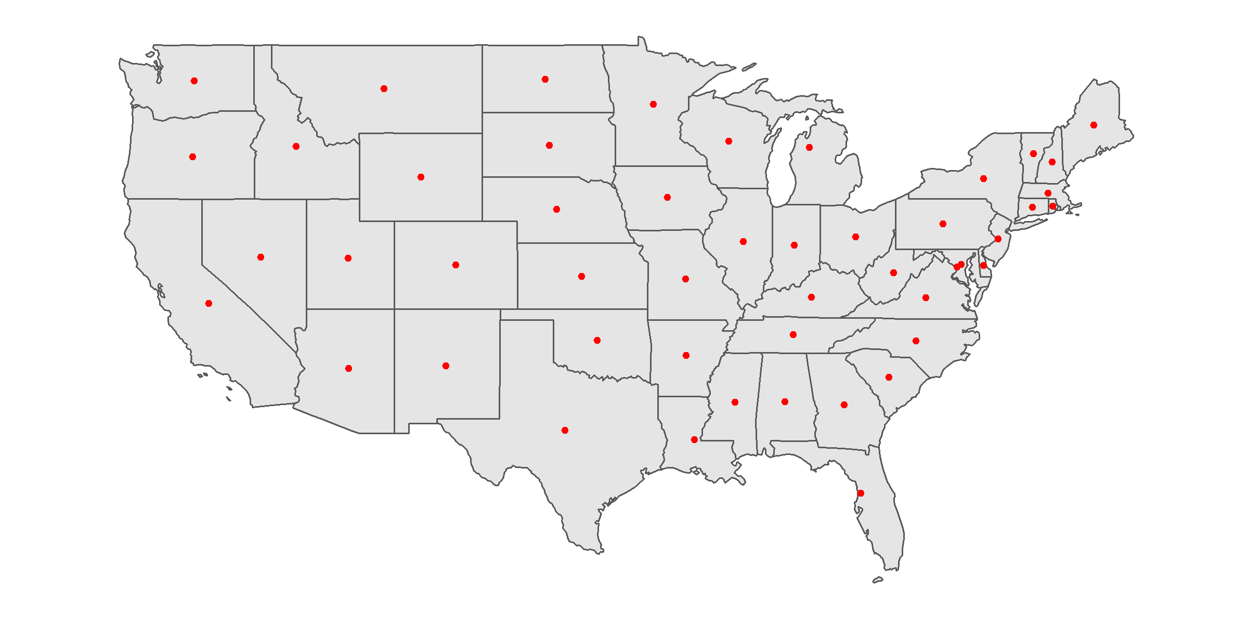
Centroid
# centroid of each state
us_states_centroid=st_centroid(us_states)

Slide 26
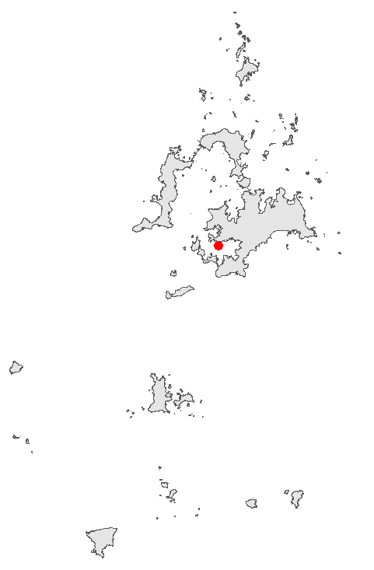
Centroid
# polygon of Penghu County
penghu=filter(taiwan_county, COUNTYCODE==10016)
# centroid of Penghu
penghu_centroid=st_centroid(penghu)
Not on the land!!
How to ensure that the point lies on the land?

Slide 27
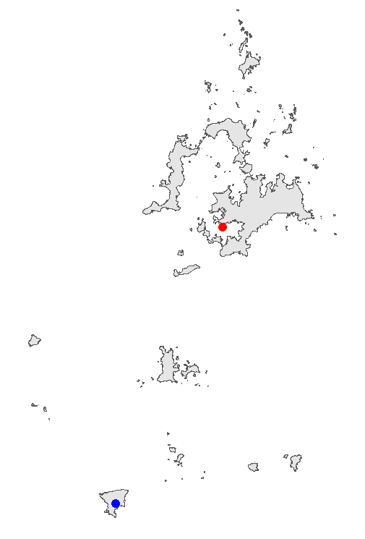
Centroid
# use st_point_on_surface
penghu_point=st_point_on_surface(penghu)

Slide 28
Buffer
st_buffer(GEODATA, radius)
# buffer of London shared bike stations
st_buffer(cycle_hire, 300)
## Warning in st_buffer.sfc(st_geometry(x), dist, nQuadSegs, endCapStyle =
## endCapStyle, : st_buffer does not correctly buffer longitude/latitude data
## dist is assumed to be in decimal degrees (arc_degrees).
Why does a warning exist?
Note the CRS and units!!

Slide 29
Buffer
Check CRS
# check CRS
st_crs(cycle_hire)$epsg
## [1] 4326
st_crs(cycle_hire)$units
## NULL
CRS | Feature | Unit | Example
GCS | Ellipsoid: (longitude, latitude) | Degree | EPSG:4326
PCS | Plane: (X, Y) | Metre | EPSG:3826
NULL（angle）

Slide 30
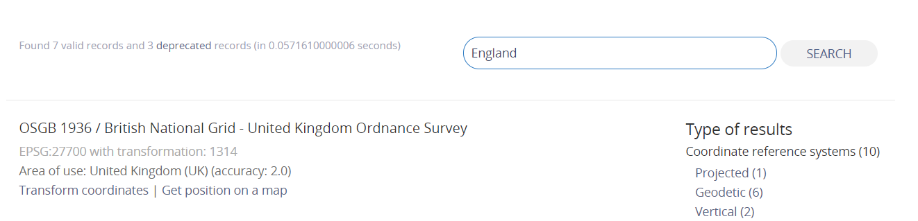

Buffer
Transform CRS
# convert CRS
cycle_hire_new=st_transform(cycle_hire, crs=27700)
# check the unit after transformation
st_crs(cycle_hire_new)$units
=================================================
[1] "m"

Slide 31
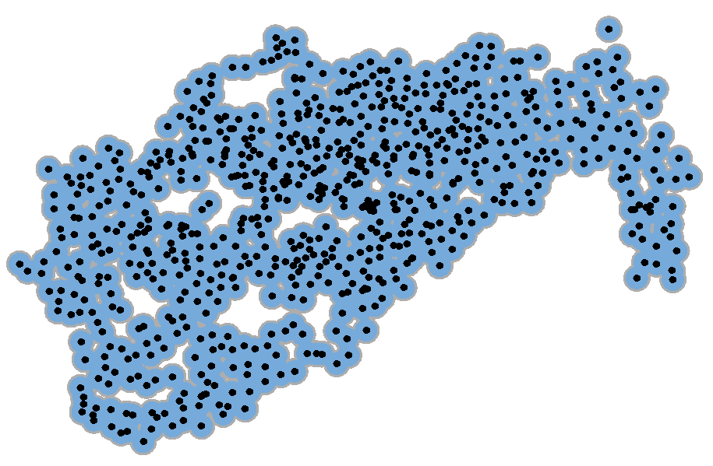
Buffer
Buffer Analysis
# 300 metres buffer of shared bile station
st_buffer(cycle_hire_new, 300)
## Simple feature collection with 742 features and 5 fields
## Geometry type: POLYGON
## Dimension: XY
## Bounding box: xmin: 522202 ymin: 174108 xmax: 539033.2 ymax: 184721
## Projected CRS: OSGB 1936 / British National Grid
## First 5 features:
## id name area nbikes nempty geometry
## 1 1 River Street Clerkenwell 4 14 POLYGON ((531503.5 182832.1...
## 2 2 Phillimore Gardens Kensington 2 34 POLYGON ((525508.1 179391.9...
## 3 3 Christopher Street Liverpool Street 0 32 POLYGON ((533285.8 182001.6...
## 4 4 St. Chad‘s Street King’s Cross 4 19 POLYGON ((530737.8 182912, ...
## 5 5 Sedding Street Sloane Square 15 12 POLYGON ((528351 178742, 52...

Slide 32
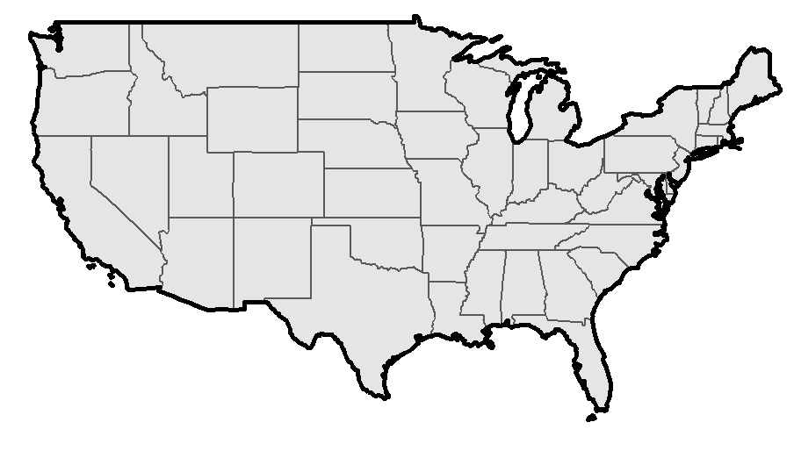
Boundary
# boundary of the union of states
us_boundary=st_boundary(st_union(us_states))

Slide 33
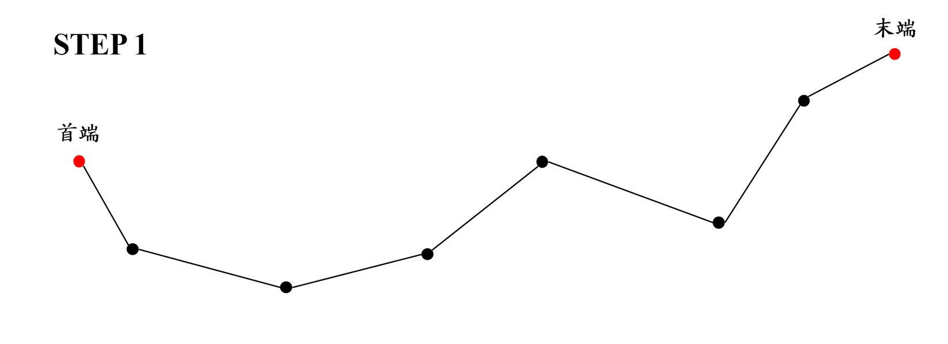
Simplify
Ramer–Douglas–Peucker Algorithm

Slide 34
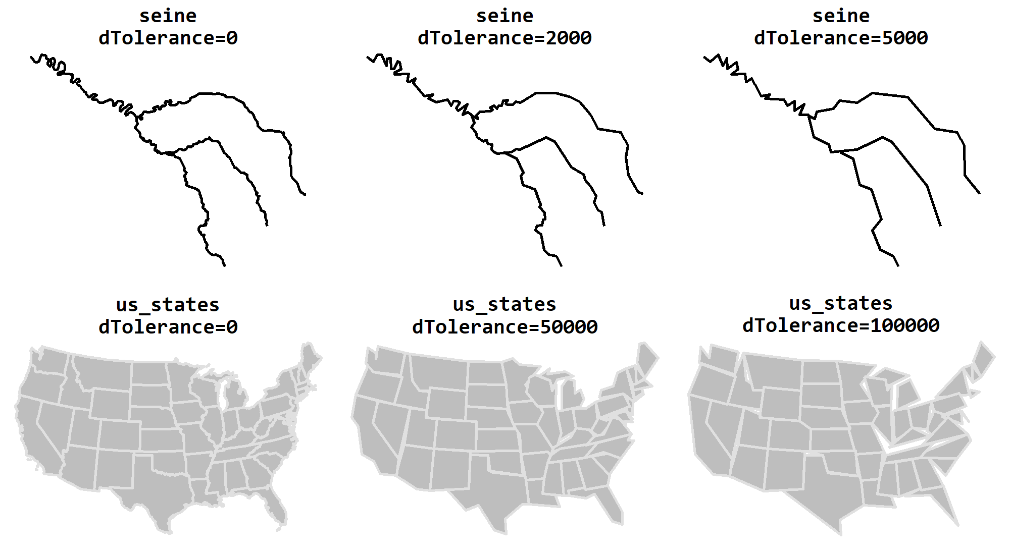

Simplify
$$ε$$
st_simplify(GEODATA, tolerance)
Unit: metre
# simplify Seine river
st_simplify(seine, dTolerance=2000)
# simplify US map
us_states_2163=st_transform(us_states, crs=2163)
st_simplify(us_states_2163, dTolerance=50000)
Transform CRS in advance

Slide 35
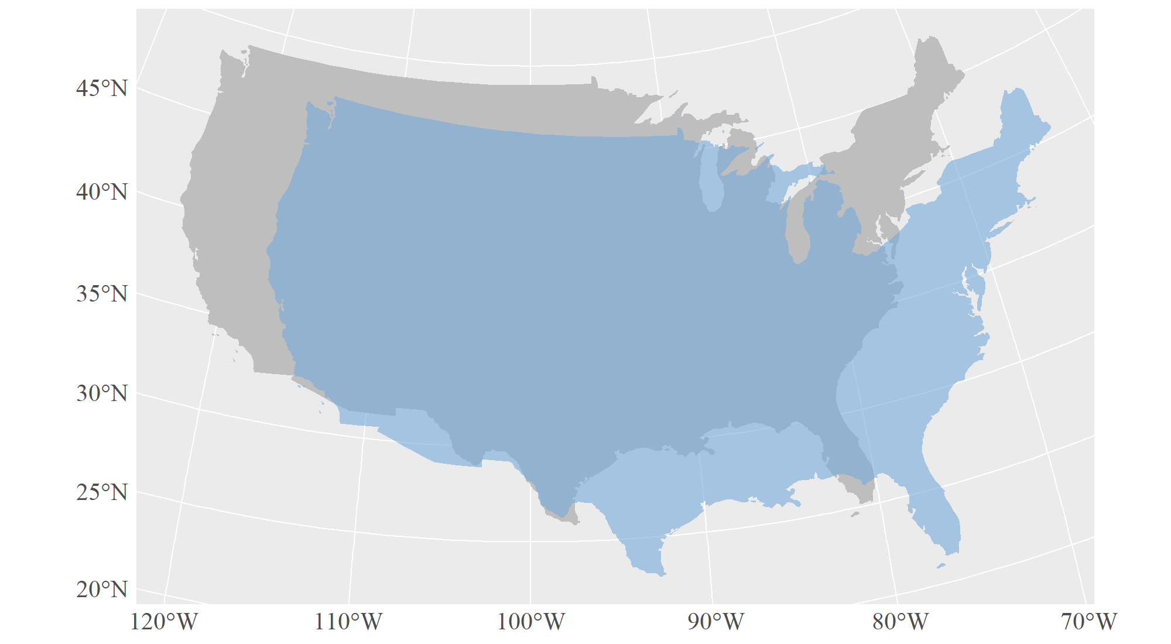
Move, Rotation, Scaling
Move
GEODATA$geometry=GEODATA$geometry+c(X_move, Y_move)
# conver CRS
us_states_2163=st_transform(us_states, crs=2163)
us_states_shift=us_states_2163
# move
us_states_shift$geometry=us_states_shift$geometry+c(500000,-300000)

Slide 36

Move, Rotation, Scaling
Rotation
$$R=\left[\begin{matrix}\cos{θ} & −sin{θ} \\ \sin{θ} & \cos{θ}\end{matrix}\right]$$
# define the rotation function
rotation=function(x){
r=x*pi/180
ro=matrix(c(cos(r), sin(r), -sin(r), cos(r)), nrow=2, ncol=2)
return(ro)
}
centroid=st_centroid(GEODATA)$geometry
GEODATA$geometry=(GEODATA$geometry-centroid)*rotation(angle)+centroid

Slide 37
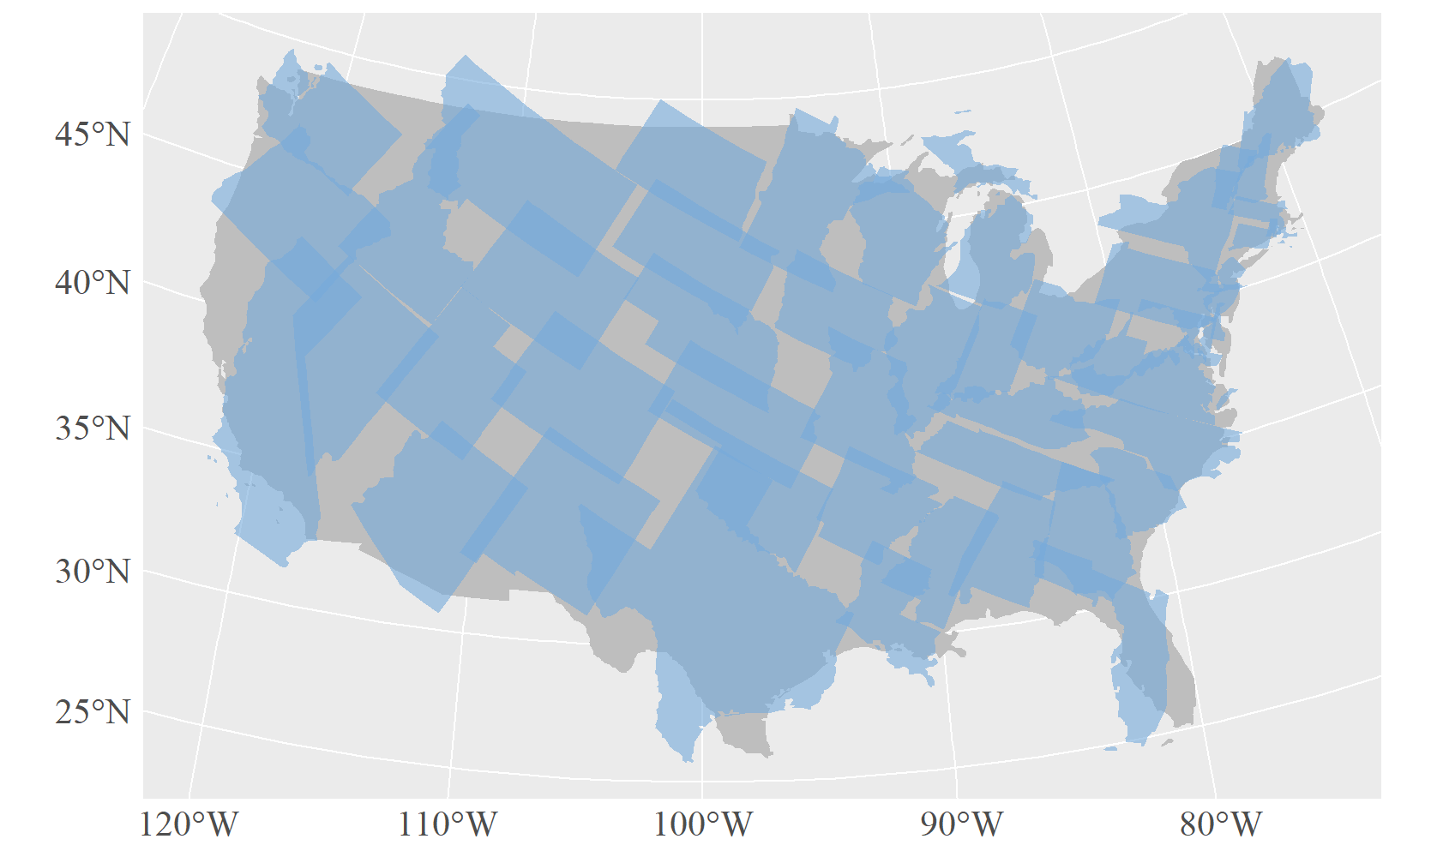
Move, Rotation, Scaling
Rotation
us_states_rotation=st_transform(us_states, crs=2163)
# rotate
us_states_center=st_centroid(us_states_rotation)$geometry
us_states_rotation$geometry=(us_states_rotation$geometry-us_states_center)*rotation(30) +us_states_center
# rest CRS
us_states_rotation=st_sf(us_states_rotation, crs=2163)
rotate 30°clockwisely

Slide 38
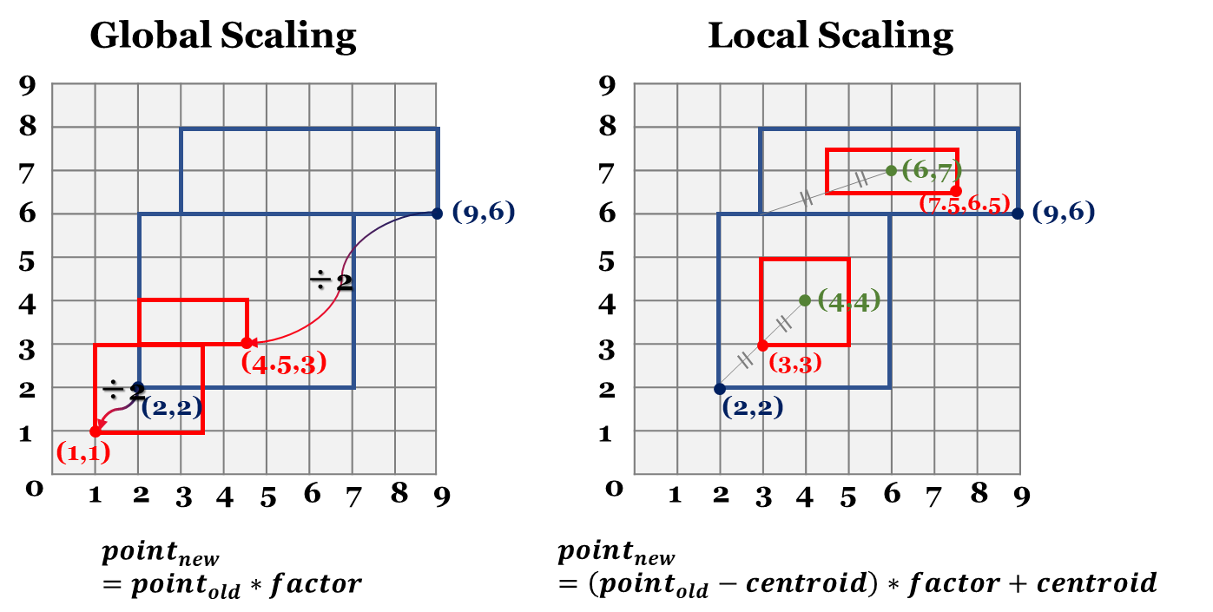
Move, Rotation, Scaling
Scaling
Global Scaling
GEODATA$geometry=GEODATA$geometry*Scale_Factor
Local Scaling
centroid=st_centroid(GEODATA)$geometry
GEODATA$geometry=[GEODATA$geometry-centroid]*Scale_Factor+centroid

Slide 39
Move, Rotation, Scaling
Scaling
# global scaling (factor=0.5)
us_states_global=us_states_2163
us_states_global$geometry=us_states_global$geometry*0.5
# local scaling (factor=0.5)
us_states_local=us_states_2163
us_states_center=st_centroid(us_states_local)$geometry
us_states_local$geometry=(us_states_local$geometry-us_states_center)*0.5+ us_states_center
# reset CRS
us_states_global=st_sf(us_states_global, crs=2163)
us_states_local=st_sf(us_states_local, crs=2163)

Slide 40
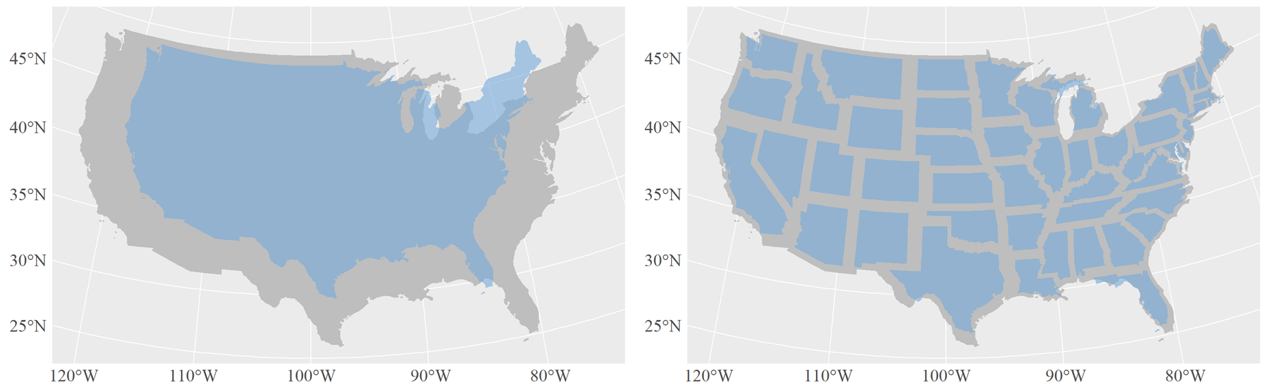
Move, Rotation, Scaling
Scaling
Global Scaling
Local Scaling
us_states_global
us_states_local

Slide 41
Spatial Computation
Area
# calculate the village area
tp_vil_area=st_area(taipei_village_map)
# merge the area field
tp_vil_area=cbind(taipei_village_map, AREA=as.numeric(tp_vil_area)/1000000)
# view tp_vil_area
head(tp_vil_area[, c("VILLCODE","COUNTYNAME","TOWNNAME","VILLNAME","AREA")])
====================================================================================
## VILLCODE COUNTYNAME TOWNNAME VILLNAME AREA geometry
## 1 63000080031 臺北市 文山區 樟新里 0.19511016 POLYGON ((306495.2 2763784,...
## 2 63000080037 臺北市 文山區 老泉里 3.77403620 POLYGON ((307616.2 2763945,...
## 3 63000080032 臺北市 文山區 樟腳里 0.17889846 POLYGON ((307328.8 2764059,...
## 4 63000080041 臺北市 文山區 樟文里 0.20580488 POLYGON ((306456.5 2764094,...
## 5 63000080043 臺北市 文山區 樟樹里 0.07583713 POLYGON ((306717.5 2764134,...
## 6 63000080029 臺北市 文山區 順興里 0.15065310 POLYGON ((307256.3 2764251,...
Unit: m²
Convert to numeric
Convert m² to km²

Slide 42
Spatial Computation
Length
# calculate the length of MRT line
mrt_length=st_length(taipei_mrt_route)
# merge the length field
mrt_length=cbind(taipei_mrt_route, as.numeric(mrt_length))
# view mrt_length
head(mrt_length[, c("RAILNAME","RAILID","mrt_length")])
==================================================================
## RAILNAME RAILID mrt_length geometry
## 1 板南線 650000199 3893.5209 LINESTRING (293985.4 276212...
## 2 松山新店線 630000001 916.1631 LINESTRING (303306.4 276817...
## 3 淡水信義線 630000002 2837.3542 LINESTRING (302728.8 276943...
## 4 松山新店線 630000003 1037.3236 LINESTRING (302723.9 276887...
## 5 中和新蘆線 630000004 1403.0698 LINESTRING (303314.6 276964...
## 6 中和新蘆線 650000005 1322.4133 LINESTRING (302024.2 276738...
Unit: m²
Convert to numeric

Slide 43
Spatial Computation
Perimeter
# retrieve the border of Taipei Village
vill_border=st_boundary(taipei_village_map)
# Calculate the length of each border
vil_peri1=st_length(vill_border)
# merge the perimeter field
tp_vil_peri=cbind(taipei_village_map, as.numeric(vil_peri1))
# view mrt_length
head(tp_vil_peri[, c("VILLCODE","COUNTYNAME","TOWNNAME","VILLNAME","vil_peri1")])
=======================================================================================
## VILLCODE COUNTYNAME TOWNNAME VILLNAME vil_peri1 geometry
## 1 63000080031 臺北市 文山區 樟新里 2011.373 POLYGON ((306495.2 2763784,...
## 2 63000080037 臺北市 文山區 老泉里 7768.440 POLYGON ((307616.2 2763945,...
## 3 63000080032 臺北市 文山區 樟腳里 2423.387 POLYGON ((307328.8 2764059,...
## 4 63000080041 臺北市 文山區 樟文里 1987.279 POLYGON ((306456.5 2764094,...
## 5 63000080043 臺北市 文山區 樟樹里 1104.554 POLYGON ((306717.5 2764134,...
## 6 63000080029 臺北市 文山區 順興里 1838.895 POLYGON ((307256.3 2764251,...
Unit: m²
Convert to numeric

Slide 44
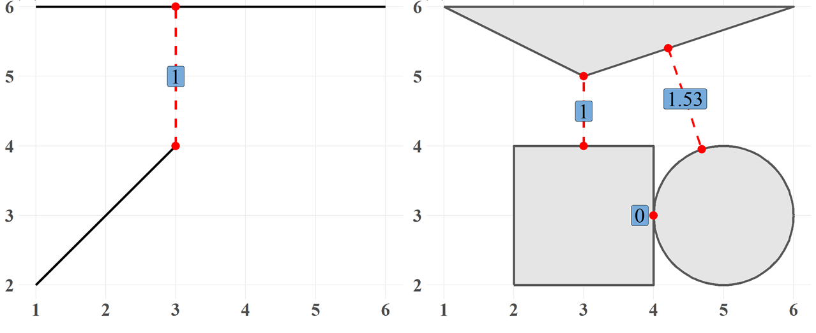
Spatial Computation
Euclidean Distance
The distance between the two points is straightforward.
How about other geometries?
Find the nearest distance of two geometries!

Slide 45
Spatial Computation
st_distance(GEODATA1, [GEODATA2], by_element=)
Function | Dist Mat. | Meanings
st_distance(GEODATA1) | n*n | Distance matrix of all pairs in a spatial data.
st_distance(GEODATA1, GEODATA2) | n*k | Distance matrix of all pairs of two spatial data.
st_distance(GEODATA1, GEODATA2, by_element=T) | 1*n （1*k） | Distance matrix by row of two spatial data.
①
②
③
n=k → number of rows must be the same！
Pairs
①
②
③
GEODATA1
A
B
C
GEODATA2
X
Y
Z
A – A
A – B
A – C
B – A
B – B
B – C
C – A
C – B
C – C
A – X
A – Y
A – Z
B –X
B –Y
B –Z
C –X
C –Y
C –Z
A – X
B – Y
C – Z

Slide 46
GEODATA2
# top 5 data in bike station
ubike_station=taipei_youbike[1:5,]
ubike_station$StatnNm ## view station name
=============================================
## [1] "YouBike1.0_捷運市政府站(3號出口)"
## [2] "YouBike1.0_捷運國父紀念館站(2號出口)"
## [3] "YouBike1.0_台北市政府"
## [4] "YouBike1.0_市民廣場"
## [5] "YouBike1.0_興雅國中"
Spatial Computation
# top 5 data in MRT station
mrt_station=taipei_mrt_station[1:5,]
mrt_station$Zh_tw ## view station name
==================================================
## [1] "動物園" "木柵" "萬芳社區" "萬芳醫院" "辛亥"
GEODATA1
# distance matrix of all pairs of MRT stations
st_distance(mrt_station)
==============================================
## Units: [m]
## [,1] [,2] [,3] [,4] [,5]
## [1,] 0.0000 643.4393 1152.8001 2164.6601 2404.7191
## [2,] 643.4393 0.0000 509.9757 1522.4162 1809.3231
## [3,] 1152.8001 509.9757 0.0000 1012.4590 1350.5346
## [4,] 2164.6601 1522.4162 1012.4590 0.0000 687.7042
## [5,] 2404.7191 1809.3231 1350.5346 687.7042 0.0000
動物園
木柵
萬芳社區
萬芳醫院
辛亥
動物園
木柵
萬芳社區
萬芳醫院
辛亥

Slide 47
Spatial Computation
# distance matrix of all pairs of MRT and bike stations
st_distance(mrt_station, ubike_station)
==============================================
## Units: [m]
## [,1] [,2] [,3] [,4] [,5]
## [1,] 4867.336 5263.475 4617.887 4534.858 4387.414
## [2,] 4749.977 5021.322 4454.619 4326.176 4268.841
## [3,] 4684.122 4849.006 4355.038 4190.555 4208.854
## [4,] 4706.385 4645.375 4321.432 4089.292 4261.131
## [5,] 4071.706 3965.509 3675.055 3429.007 3639.862
捷運市政府站 (3號出口)
捷運國父紀念館站(2號出口)
台北 市政府
市民 廣場
興雅
國中
動物園
木柵
萬芳社區
萬芳醫院
辛亥
# distance matrix of all pairs of MRT and bike stations (by row)
st_distance(mrt_station, ubike_station, by_element=T)
=======================================================
## Units: [m]
## [1] 4867.336 5021.322 4355.038 4089.292 3639.862

Slide 48
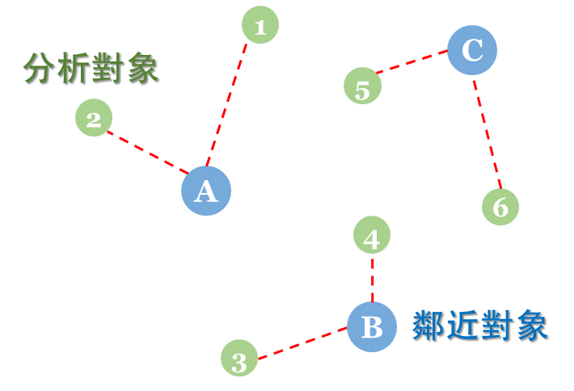
Nearest Analysis
Target Node
Find the nearest Search Node for each Target Node
e.g.,
The nearest search node of TN₁ is SN_{A}
The nearest search node of TN₅ is SN_{C}
Search Node
st_nearest_feature(Target Node, Search Node)
Retrieve the index of the nearest Search Node of each Target Node.

Slide 49
Nearest Analysis
# the nearest MRT station of each bike station
ubike_nearest_mrt=st_nearest_feature(taipei_youbike, taipei_mrt_station)
===========================================================================
## [1] 116 115 116 26 25 26
Target Node
Search Node
The index of the nearest search node of the first target node is 116.
# attach all the attributes based on index and remove the geometry
nearest_mrt=taipei_mrt_station[ubike_nearest_mrt, c("StationID","Zh_tw")]%>%
st_drop_geometry()
# merge taipei_youbike and nearest_mrt
ubike_nearest_mrt=cbind(taipei_youbike[, c("SttnUID","StatnNm")], nearest_mrt)%>%
st_drop_geometry()
索引值 (選取的橫列)

Slide 50
Nearest Analysis
# view ubike_nearest_mrt
head(ubike_nearest_mrt)
=====================================================================
## SttnUID StatnNm StationID Zh_tw
## 1 TPE0001 YouBike1.0_捷運市政府站(3號出口) BL18 市政府
## 2 TPE0002 YouBike1.0_捷運國父紀念館站(2號出口) BL17 國父紀念館
## 3 TPE0003 YouBike1.0_台北市政府 BL18 市政府
## 4 TPE0004 YouBike1.0_市民廣場 R03 台北101/世貿
## 5 TPE0005 YouBike1.0_興雅國中 R02 象山
## 6 TPE0006 YouBike1.0_臺北南山廣場 R03 台北101/世貿

Slide 51
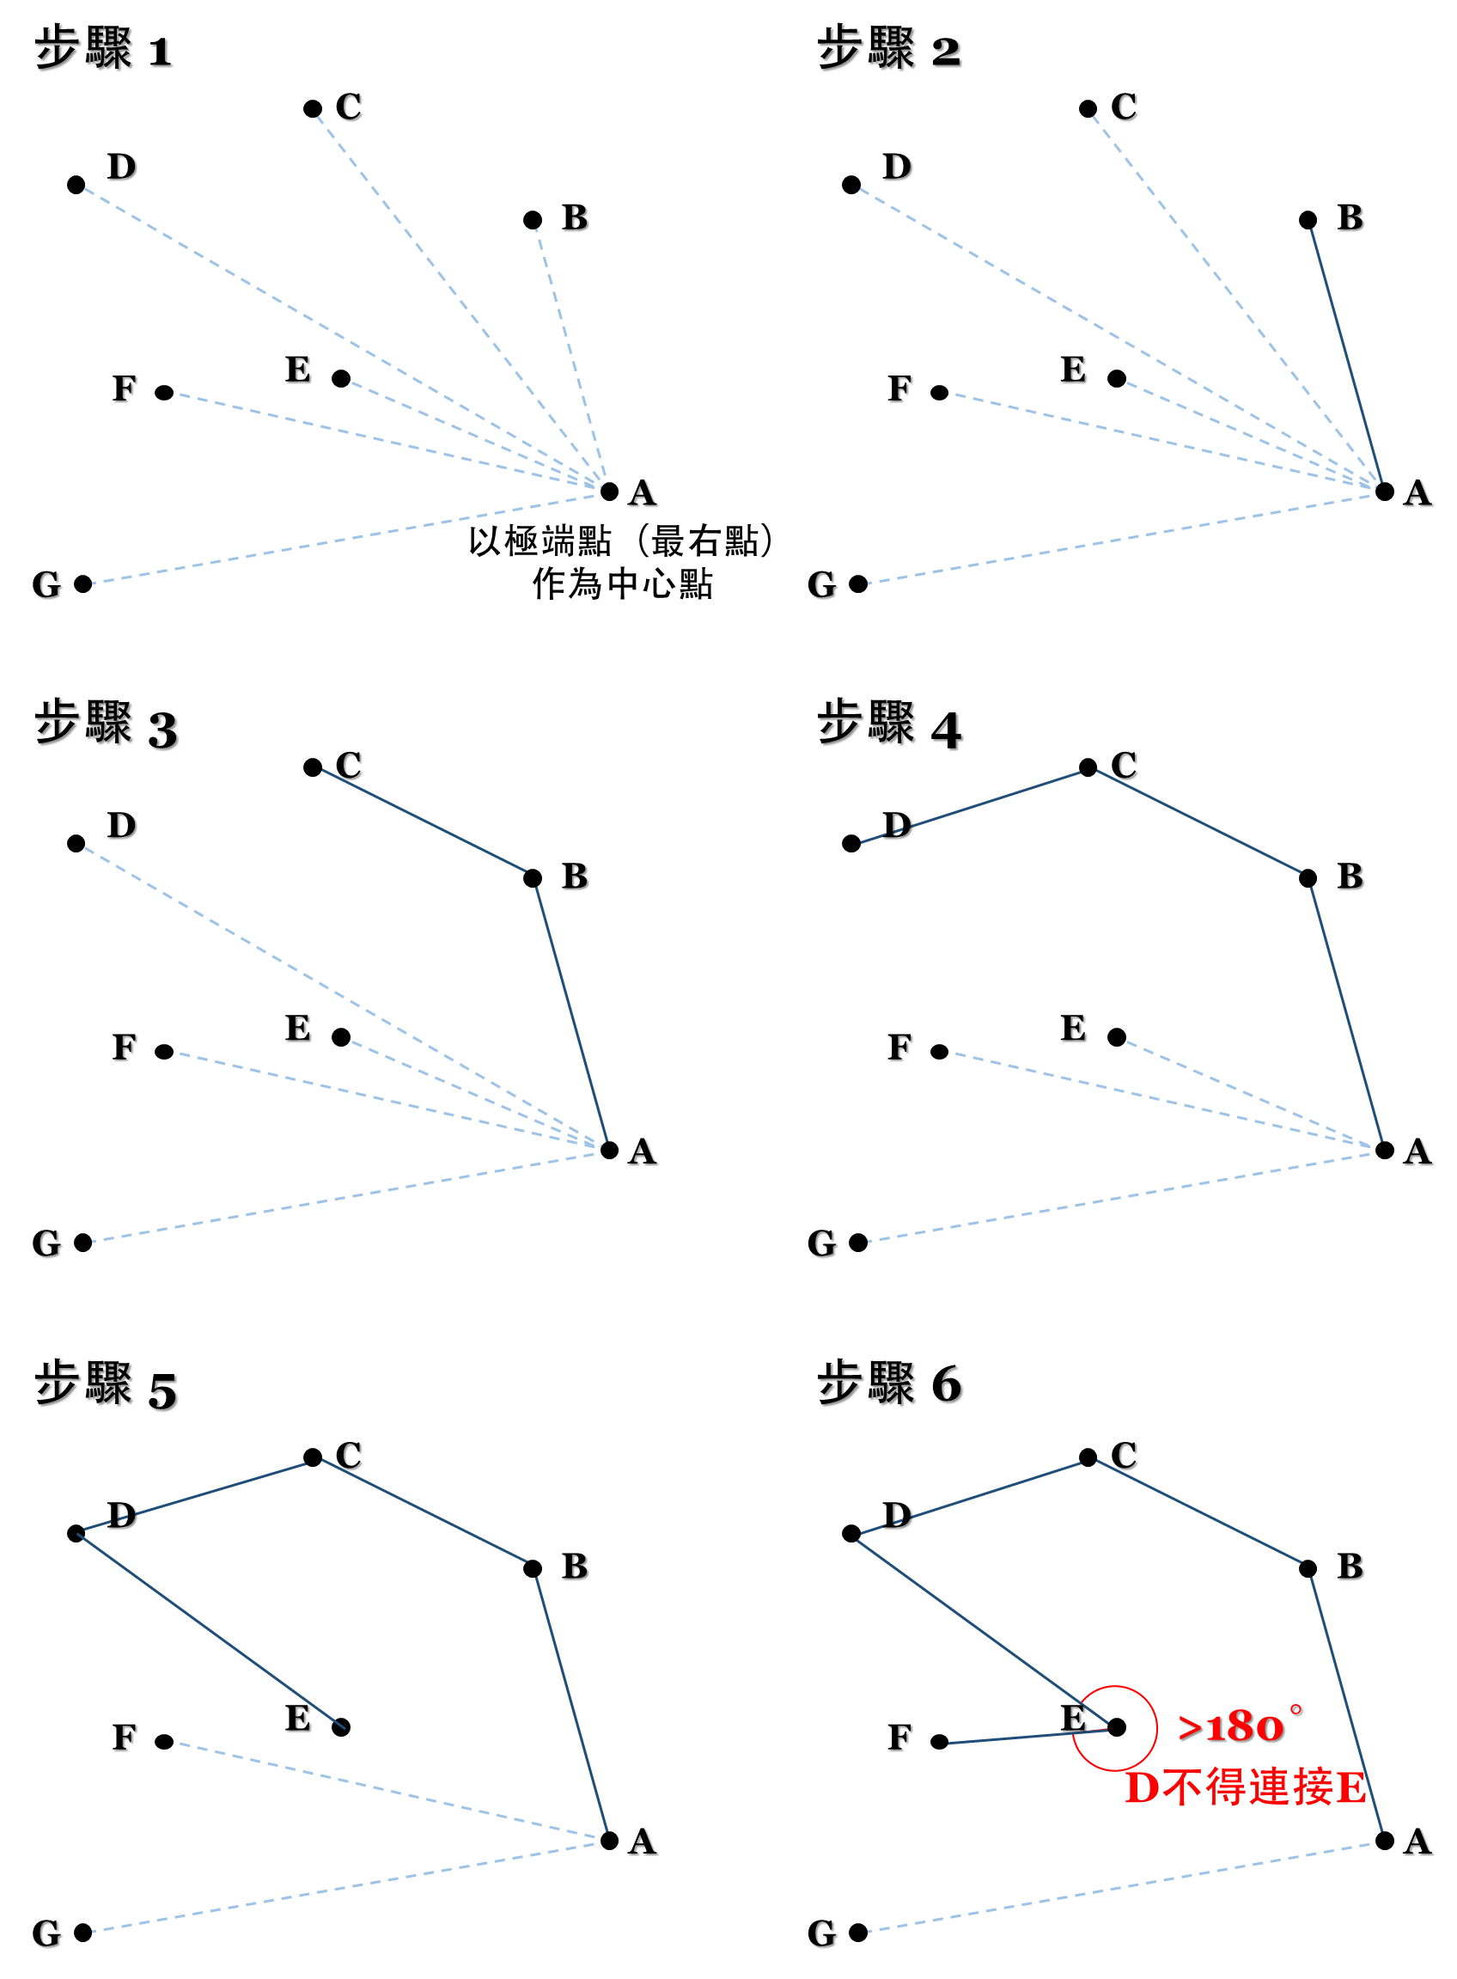
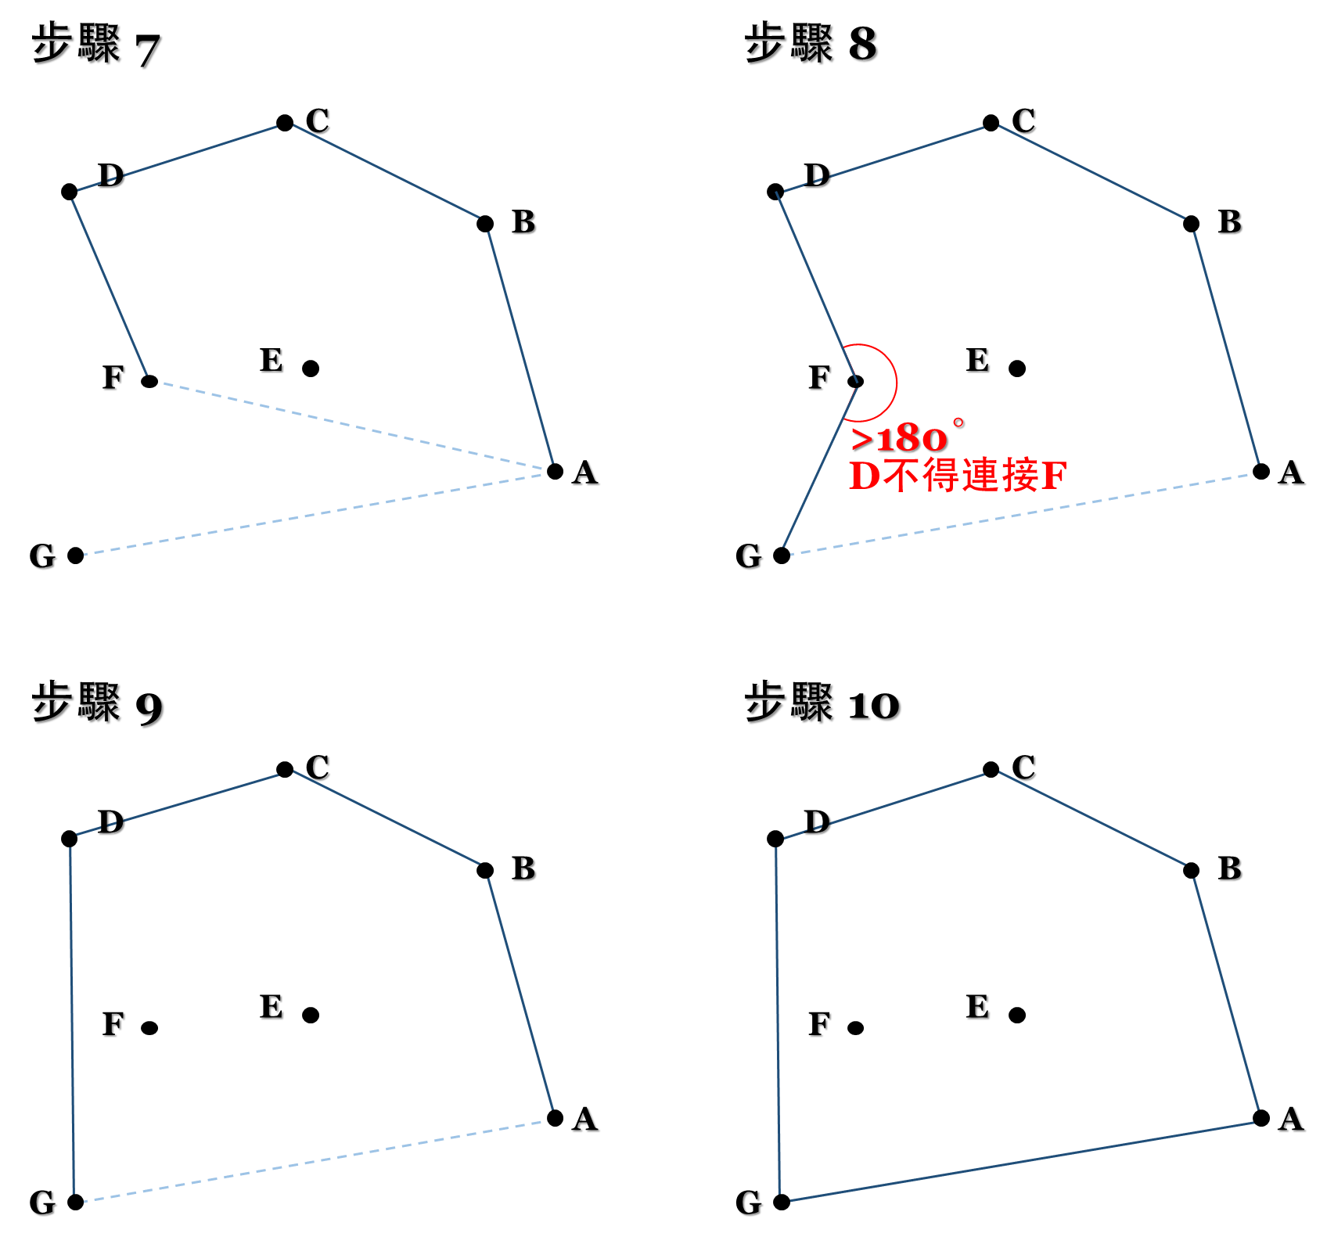
Convex Hull
Graham's Scan 演算法

Slide 52
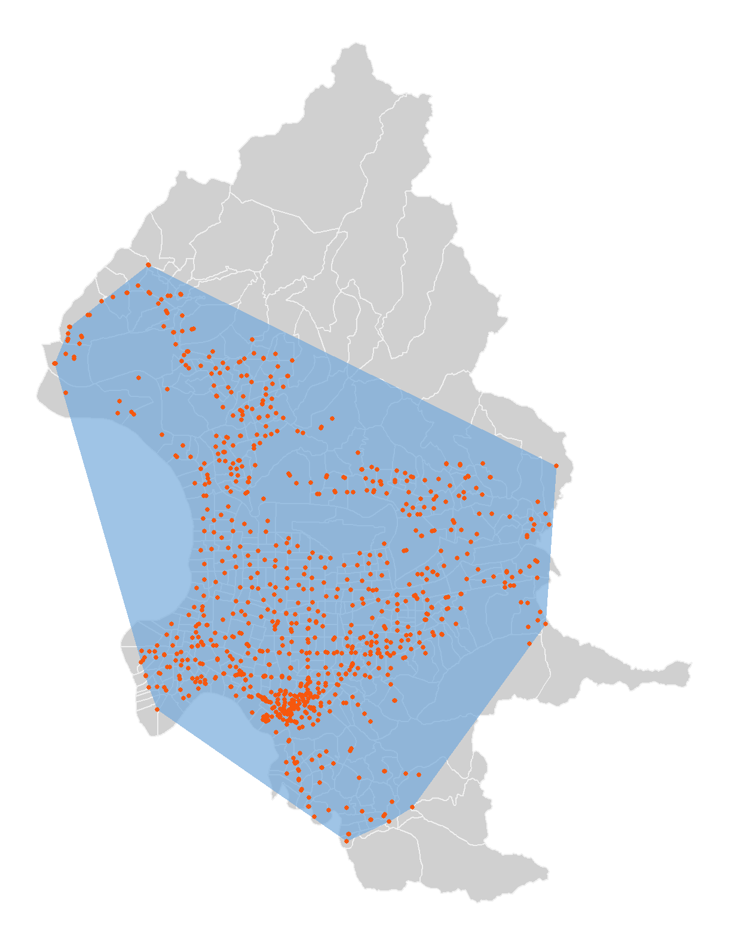
Convex Hull
st_convex_hull()
# union all YouBike stations
ubike_union=st_union(taipei_youbike)
# retrieve the convex hull
ubike_union_convex=st_convex_hull(ubike_union)
# view ubike_union_convex
ubike_union_convex
===============================================================
## Geometry set for 1 feature
## Geometry type: POLYGON
## Dimension: XY
## Bounding box: xmin:296678.9 ymin:2763509 xmax:312848.2 ymax:2782033
## Projected CRS: TWD97 / TM2 zone 121
## POLYGON ((306077.5 2763509, 299993.2 2767739, 2...

Slide 53
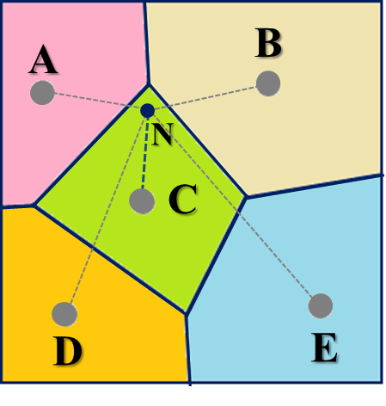
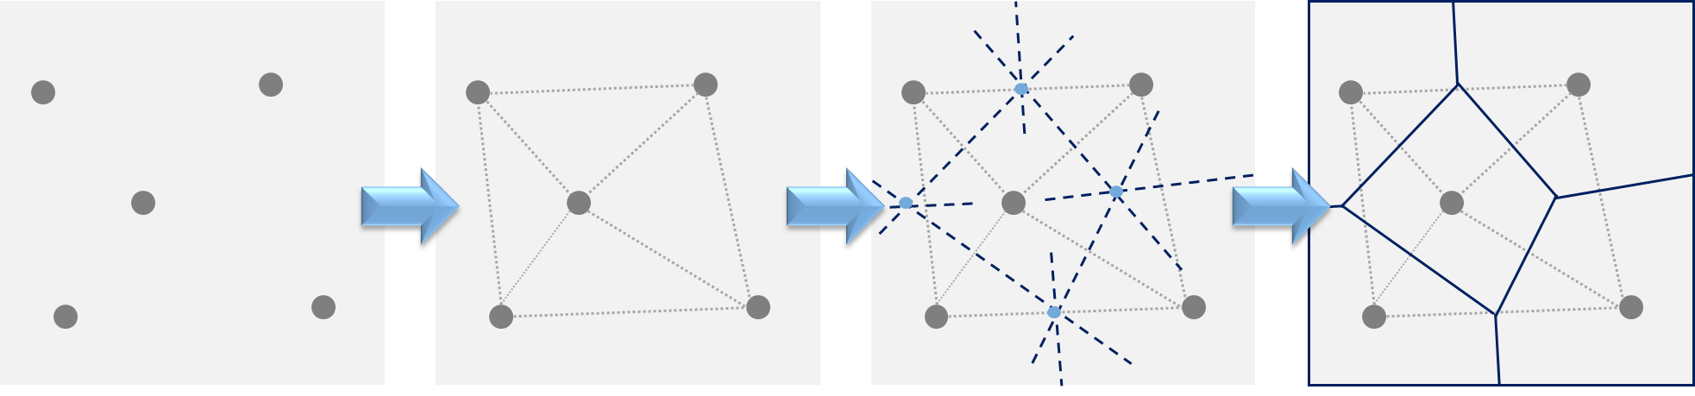
Voronoi Polygon
Feature:
The nearest point of any arbitrary points in a certain Voronoi Polygon must be the given point that generates that Voronoi Polygon.
Point N lies in the Voronoi Polygon generated by Point C
→ The nearest point for Point N must be Point C.
Given points
Make Triangles
Find Circumcentre
Make Voronoi Polygon

Slide 54
Voronoi Polygon
st_voronoi()
# union Taipei Village
tp_union=st_union(taipei_village_map)
# intersect all the MRT stations within Taipei City
mrt_station=st_intersection(taipei_mrt_station, tp_union)
# union all MRT stations and generate Voronoi Polygon
mrt_vor=st_voronoi(st_union(mrt_station))
# check data type of mrt_vor (must be GEOMETRYCOLLECTION)
class(mrt_vor)
===============================================================
## [1] "sfc_GEOMETRYCOLLECTION" "sfc"

Slide 55
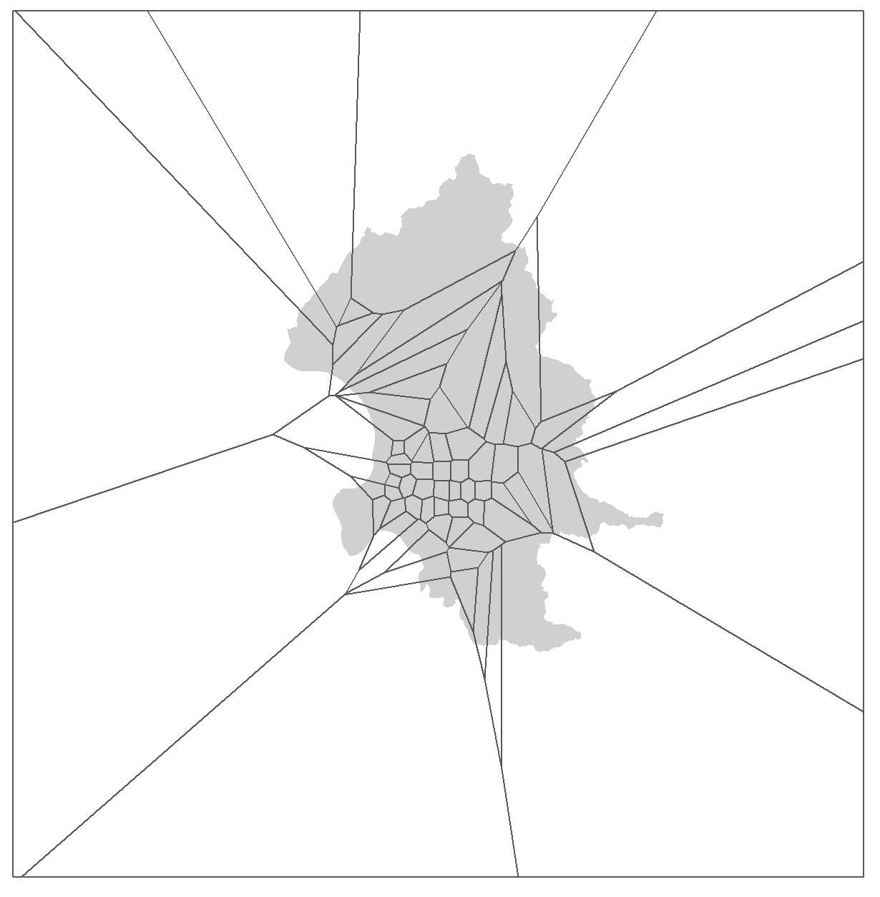
Voronoi Polygon
st_voronoi()
# convert GEOMETRYCOLLECTION to POLYGON
mrt_vor=st_collection_extract(mrt_vor, "POLYGON")
# check data type of mrt_vor (converted to POLYGON)
class(mrt_vor)
===================================================
## [1] "sfc_POLYGON" "sfc"

Slide 56
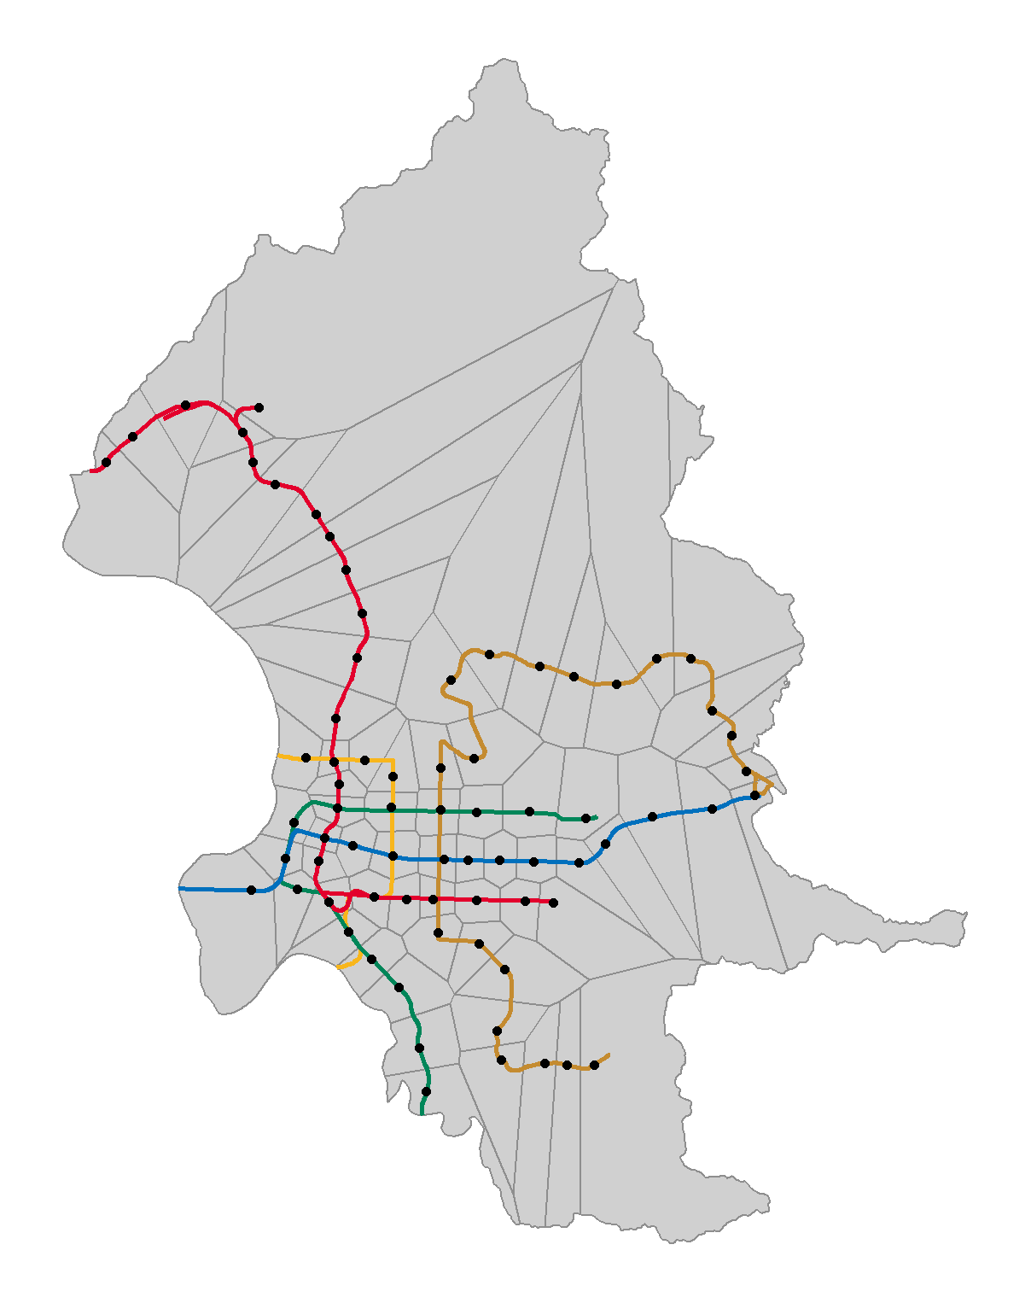
Voronoi Polygon
st_voronoi()
# clip the Voronoi Polygon in Taipei City
mrt_vor=st_intersection(mrt_vor, tp_union)
A proxy of the service area of each MRT station in Taipei City.

Slide 57
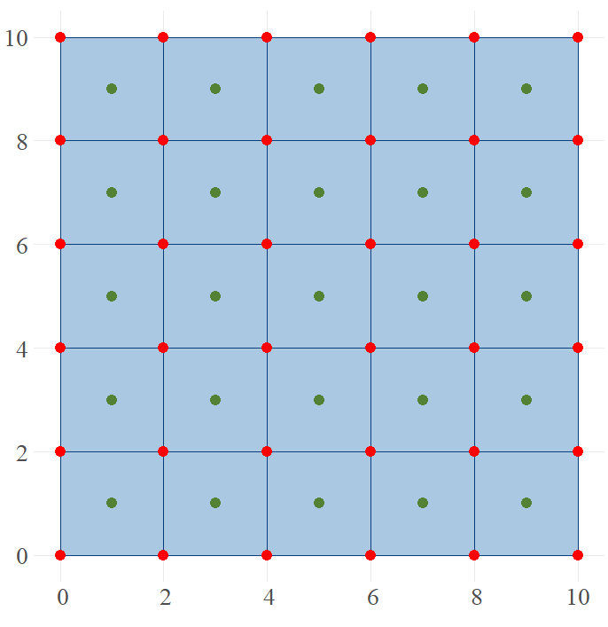
Grids
Length of grid
The number of columns and rows
st_make_grid(GEODATA, cellsize=, n=c(columns, rows), what=)
Type of grid:
Polygon
Centroid
Vertex
# make 10*10 polygons
poly10=st_polygon(list(rbind(c(0,0), c(10,0), c(10,10), c(0,10), c(0,0))))
# make polygon grids
st_make_grid(poly10, cellsize=2, what="polygons")
# make centroid of the grids
st_make_grid(poly10, cellsize=2, what="centers")
# make vertex of the grids
st_make_grid(poly10, cellsize=2, what="corners")

Slide 58
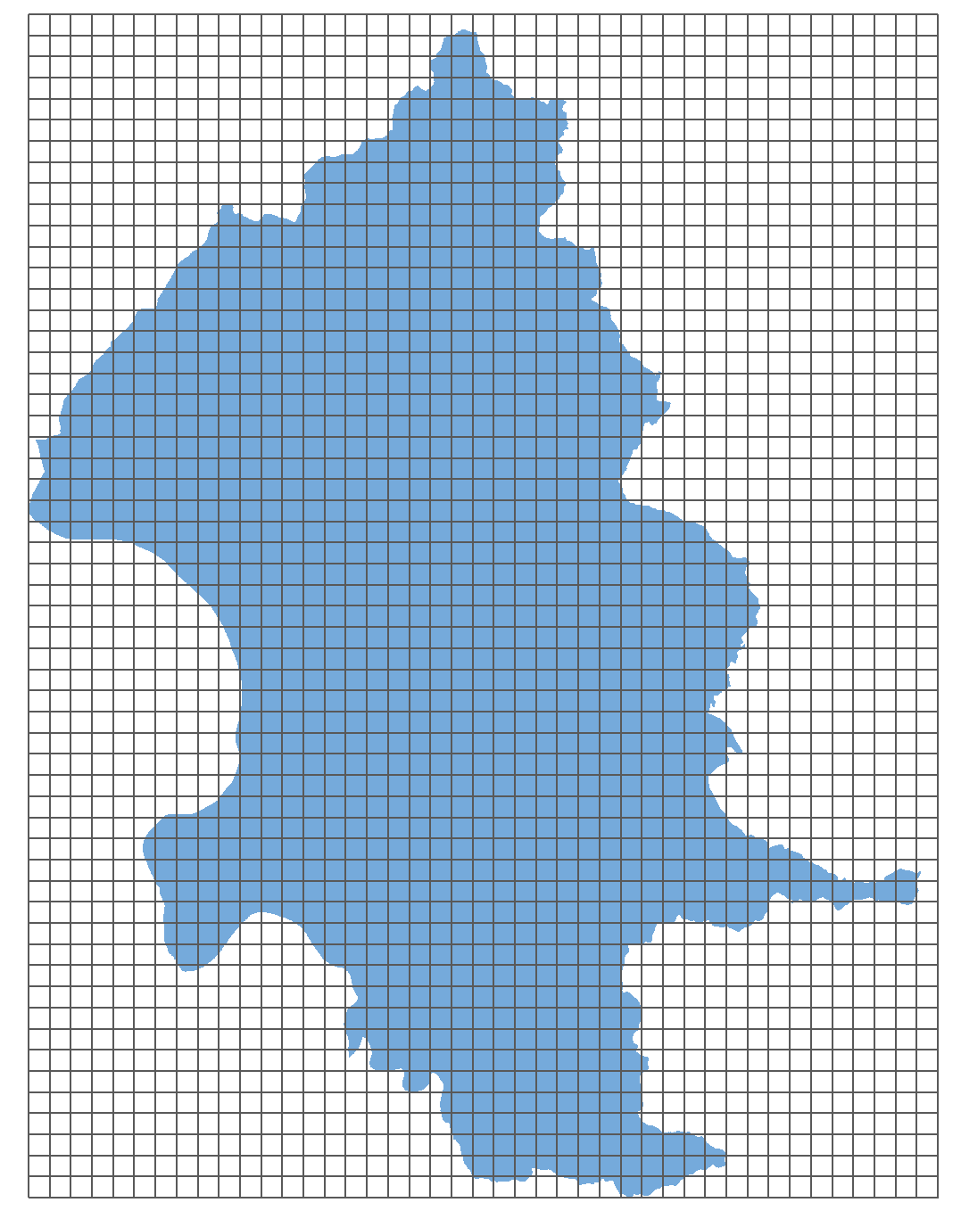
Grids
# union Taipei Village
tp_union=st_union(taipei_village_map)
# make 500*500 grids
tp_grid=st_make_grid(tp_union, cellsize=500)

